Slide 1
DCMME CONFERENCE
September 28, 2018

Slide 2
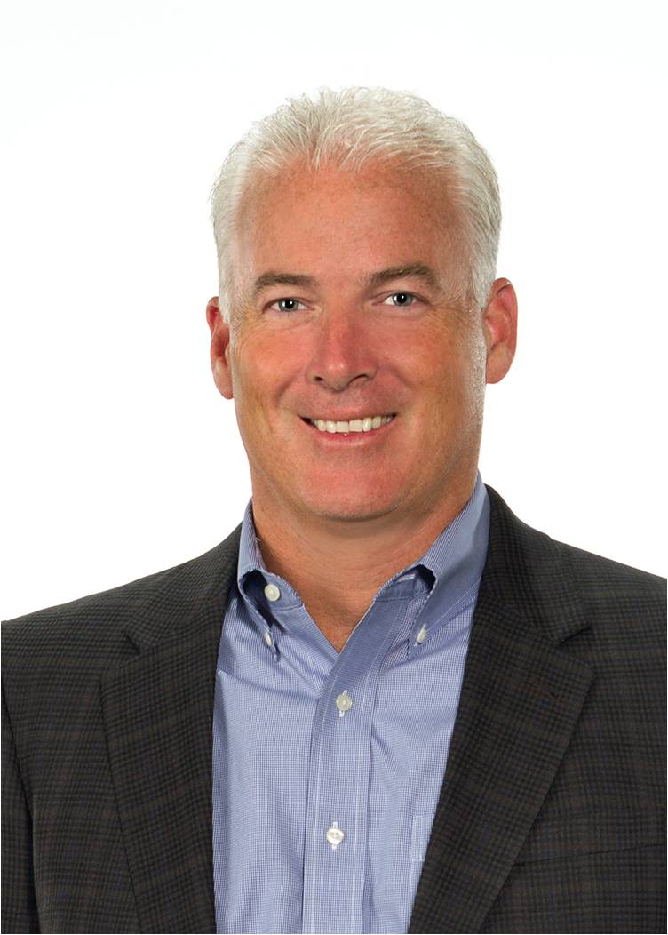
Manufacturing Innovation at Whirlpool Corporation
JIM KEPPLER
Vice President, Integrated Supply Chain & Quality
DCMME Conference / September 28, 2018

Slide 3
OUR LEADERSHIP POSITION
OUR GLOBAL PORTFOLIO OF BRANDS
DCMME Conference / September 28, 2018
Notes:
#MFGDAY18
Change logo block

Slide 4
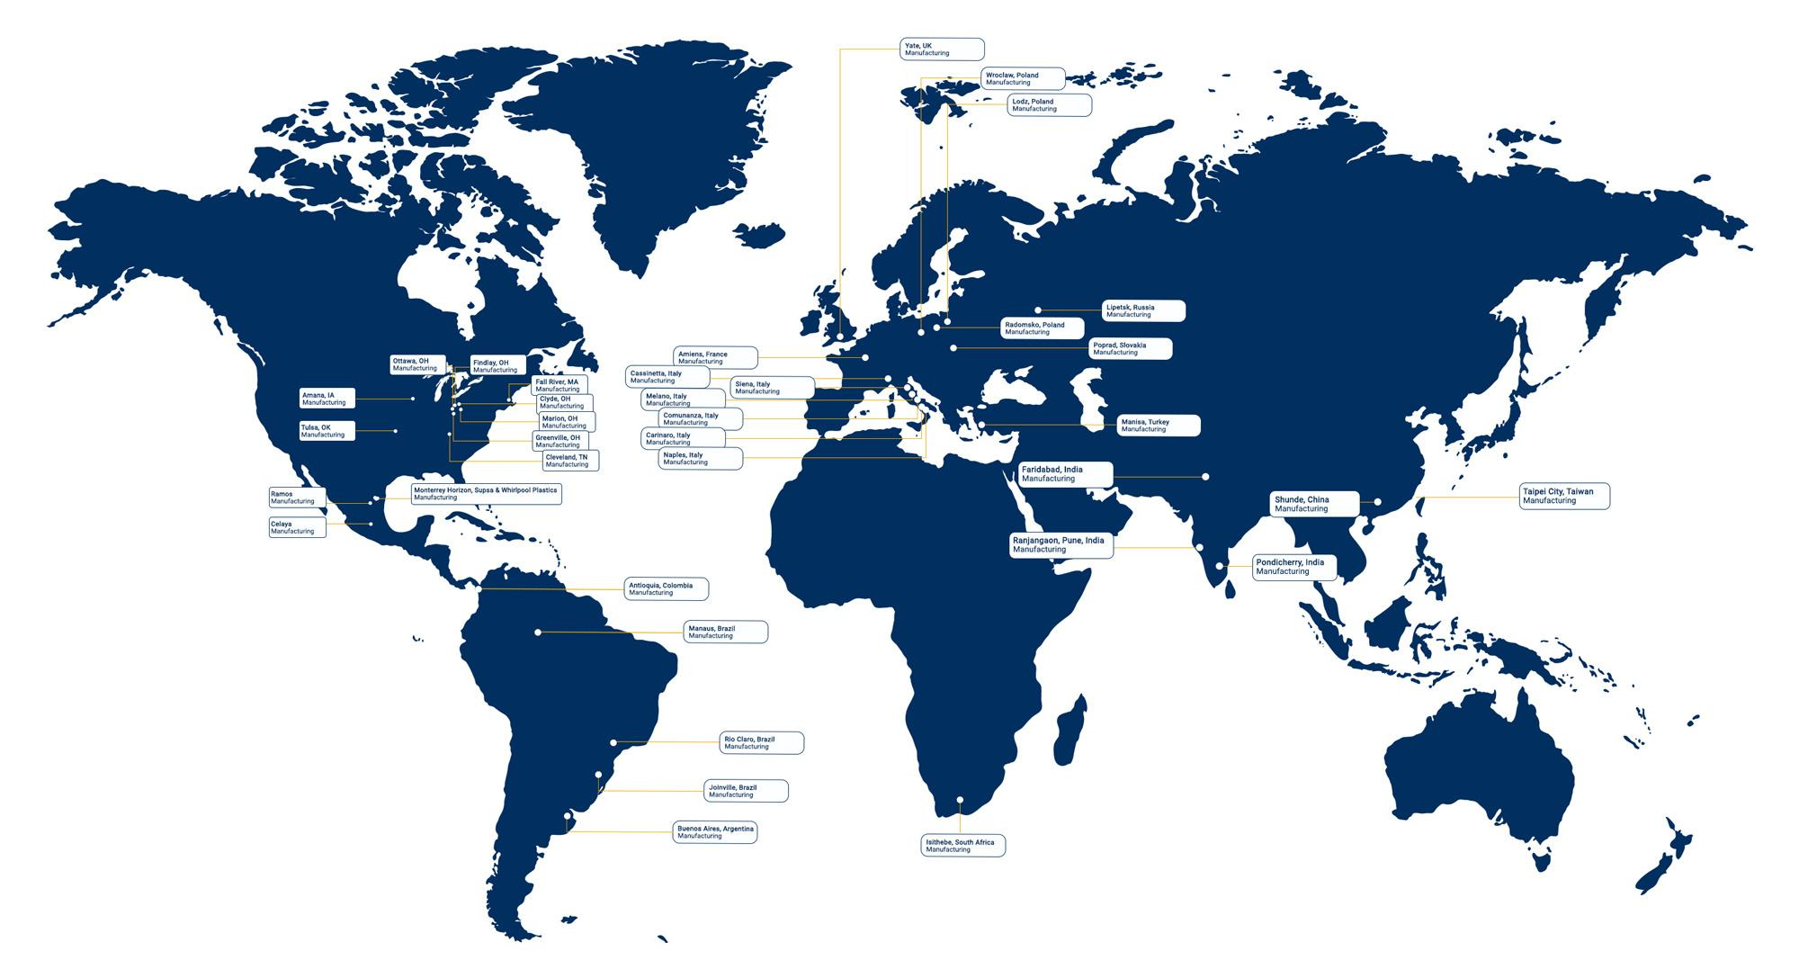
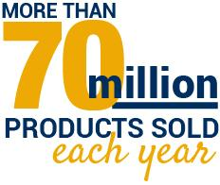
WE ARE A GLOBAL COMPANY...
NAR
EMEA
North America
Europe, Middle East and Africa
ASIA
LAR
Latin America
DCMME Conference / September 28, 2018
Notes:
Check with Gretchen if there are any updates

Slide 5
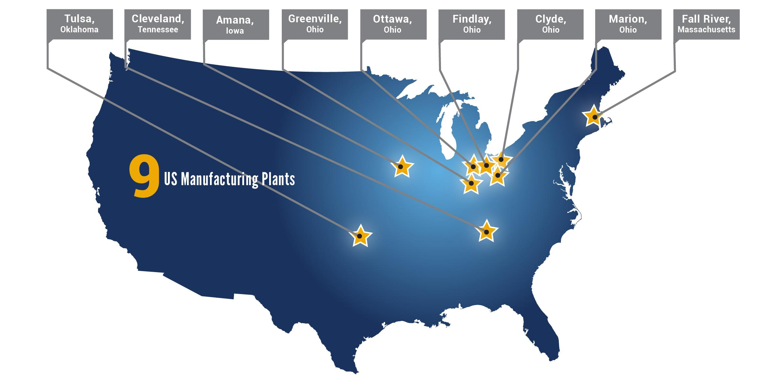
...THAT’S INVESTED IN AMERICA
DCMME Conference / September 28, 2018
Notes:
Review claims and “employees” (workers)

Slide 6
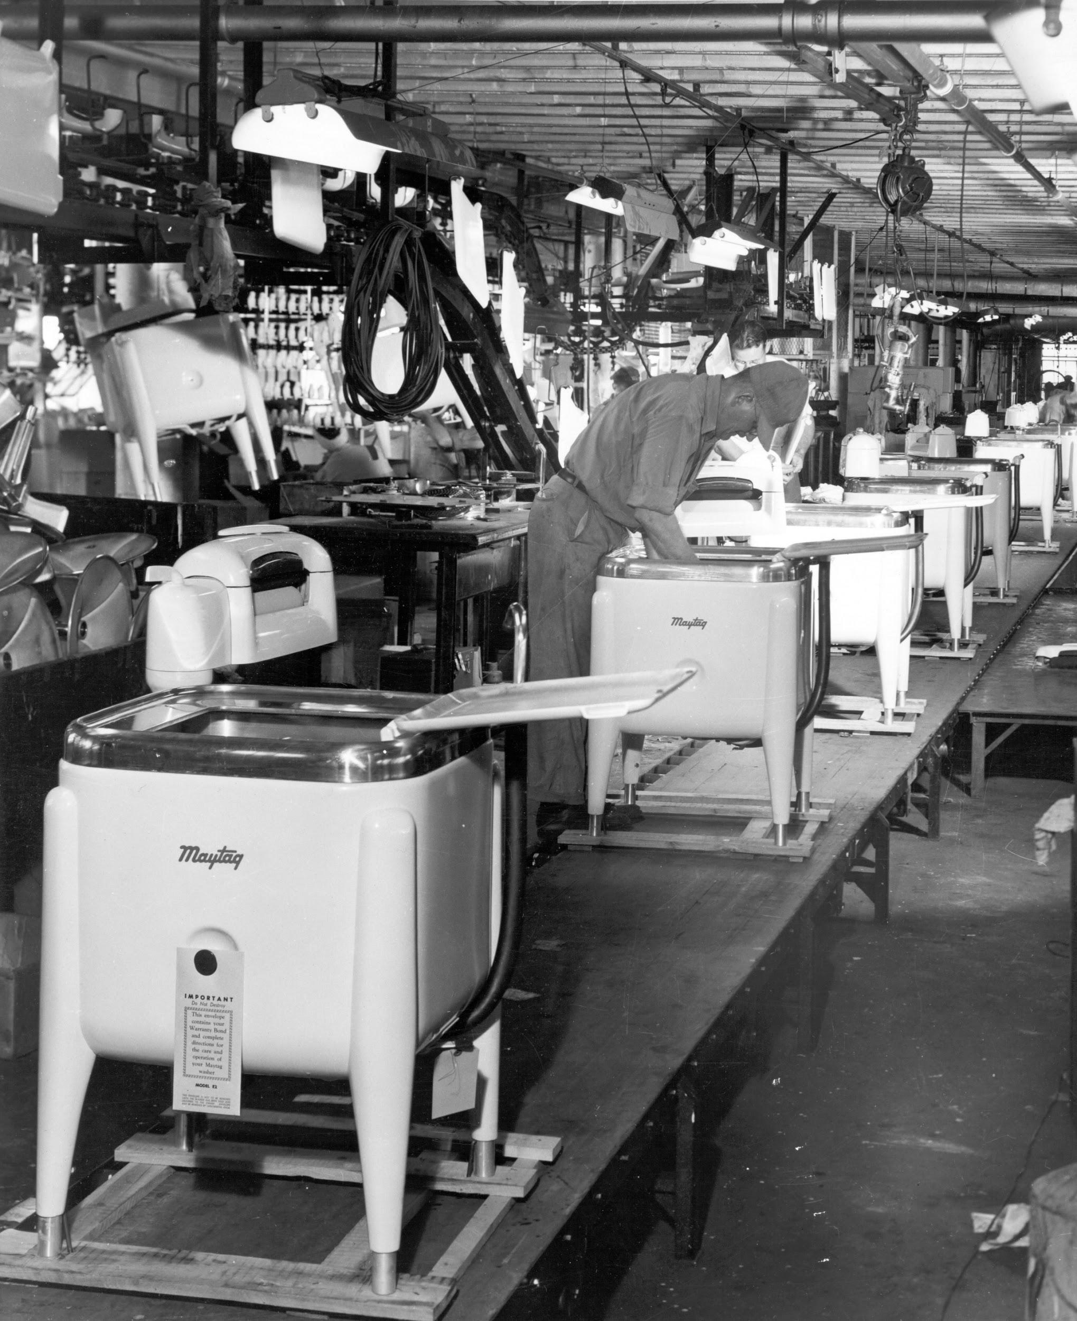
WE LEAD CHANGE AND HAVE CHANGED PERCEPTIONS
Today’s manufacturing
IS NOT YOUR GRANDFATHER’S manufacturing
Video: Clyde Pride
https://youtu.be/RweVhAybrAI
DCMME Conference / September 28, 2018

Slide 7
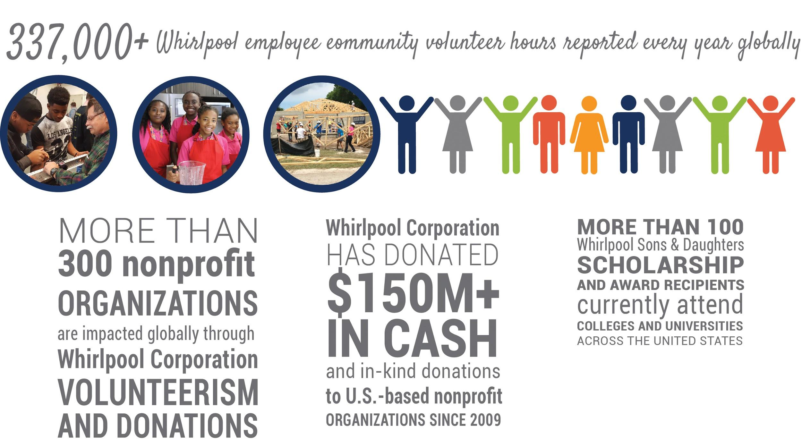
MANUFACTURING MATTERS IN OUR COMMUNITIES
DCMME Conference / September 28, 2018
Notes:
Kathy Check with Candy

Slide 8
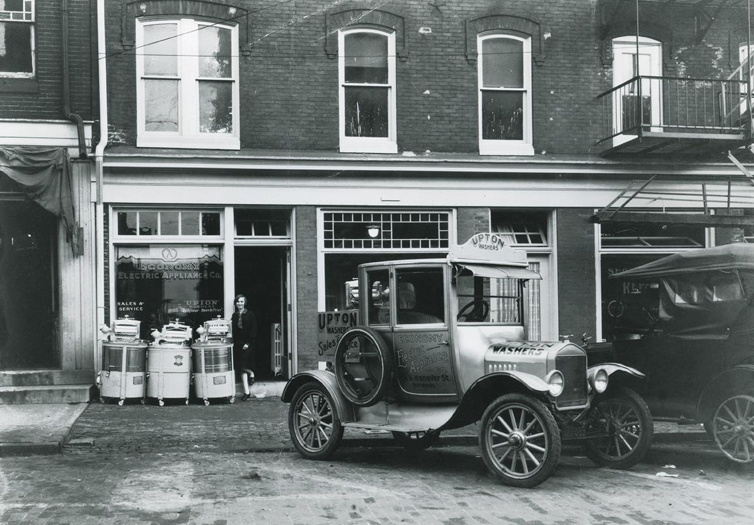
A RICH HISTORY OF ENTREPRENEURIAL SPIRIT
UPTON MACHINE COMPANY Lou Upton, Emory Upton and Lowell Bassford
INGLIS John Inglis
KITCHENAID Clarence Charles Hobart
BAUKNECHT Gotlobb Bauknecht
IGNIS Guido Borghi
CONSUL Guilherme Holderegger / Rudolf Stutzer
BRASTEMP Miguel Etchenique
MAYTAG Frederick L. Maytag
INDESIT Vittorio Merloni
DCMME Conference / September 28, 2018
Notes:
We’re ESTABLISHED with rich history
Our roots run deep.
With over 100 years of experience
We’re energized by the entrepreneurial spirit
*Image is customizable
of our founding families.

Slide 9
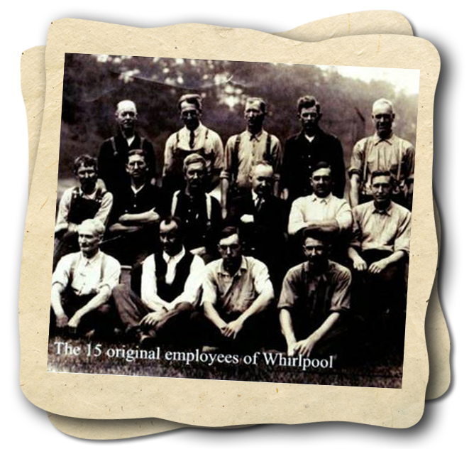
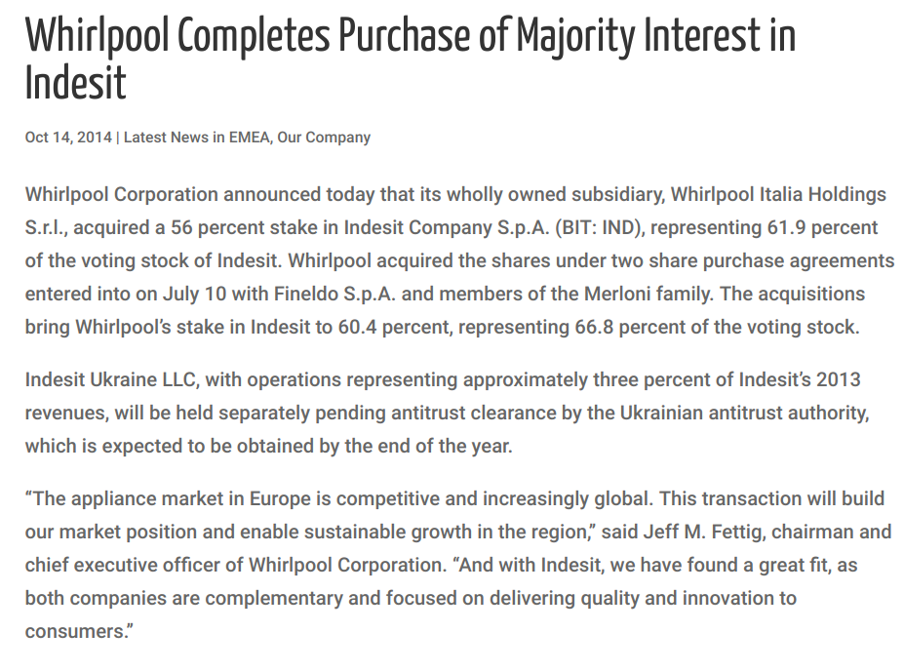
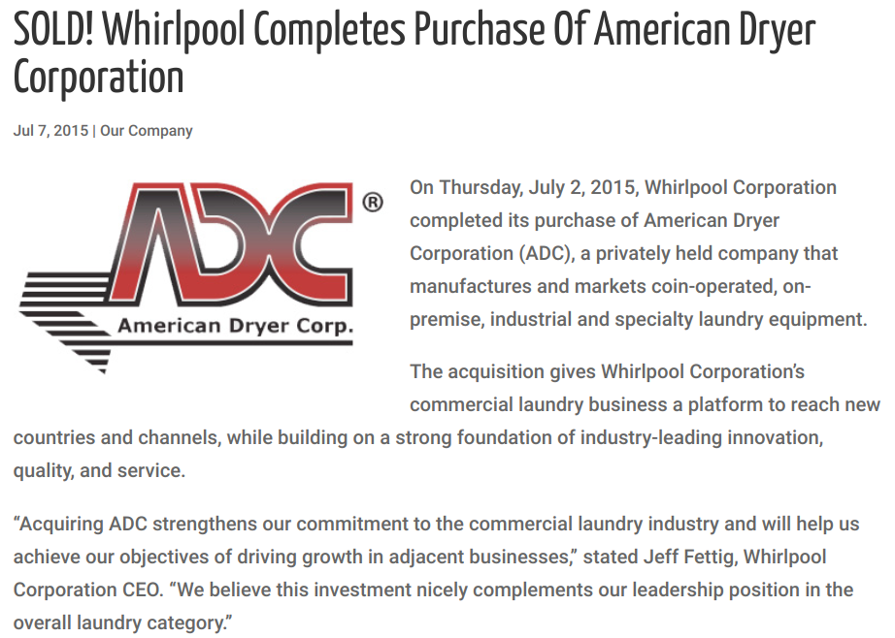
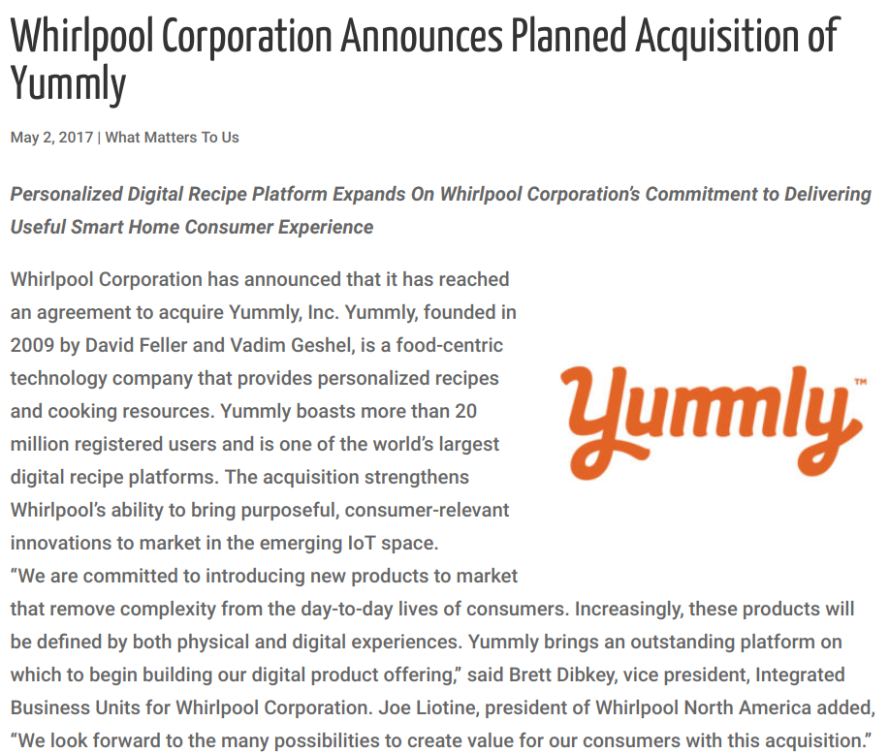
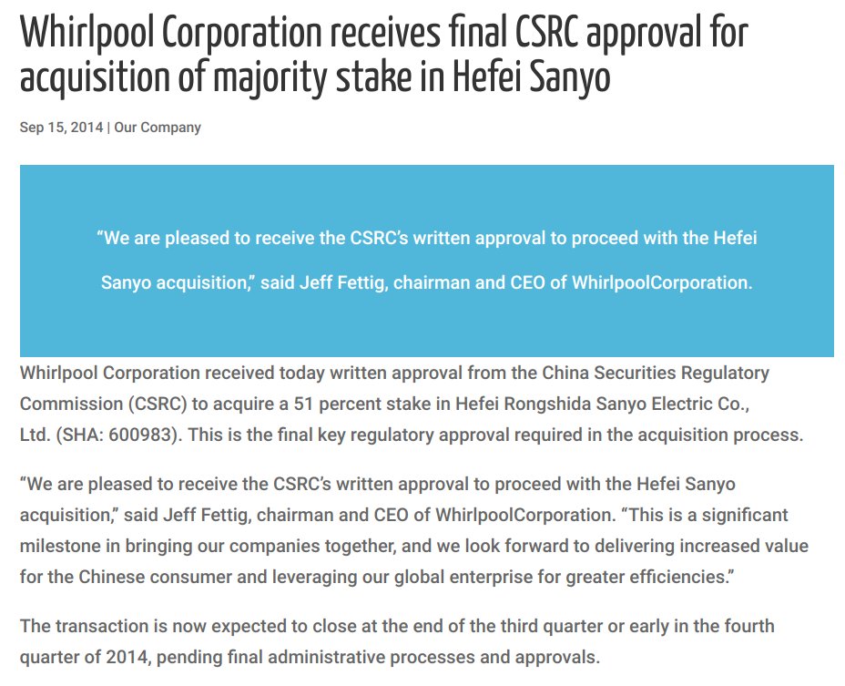
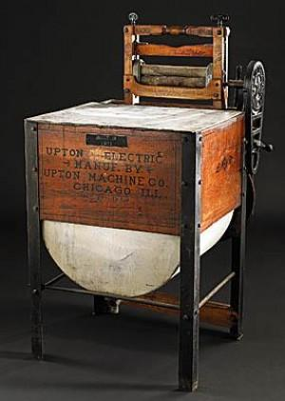
SCRAPPY STARTUPS TO GLOBAL ENTERPRISE
DCMME Conference / September 28, 2018
Notes:
Our GROWTH creates opportunities

Slide 10
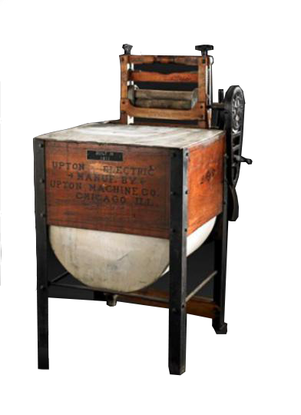
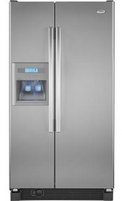
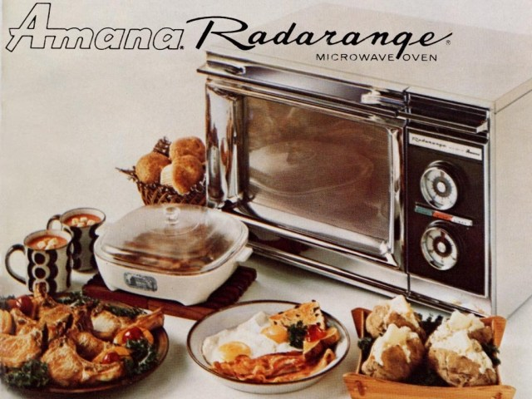
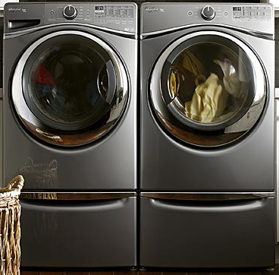
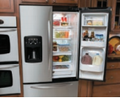
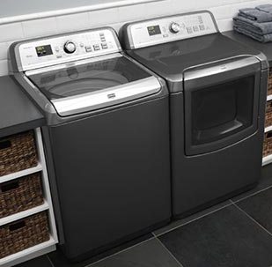
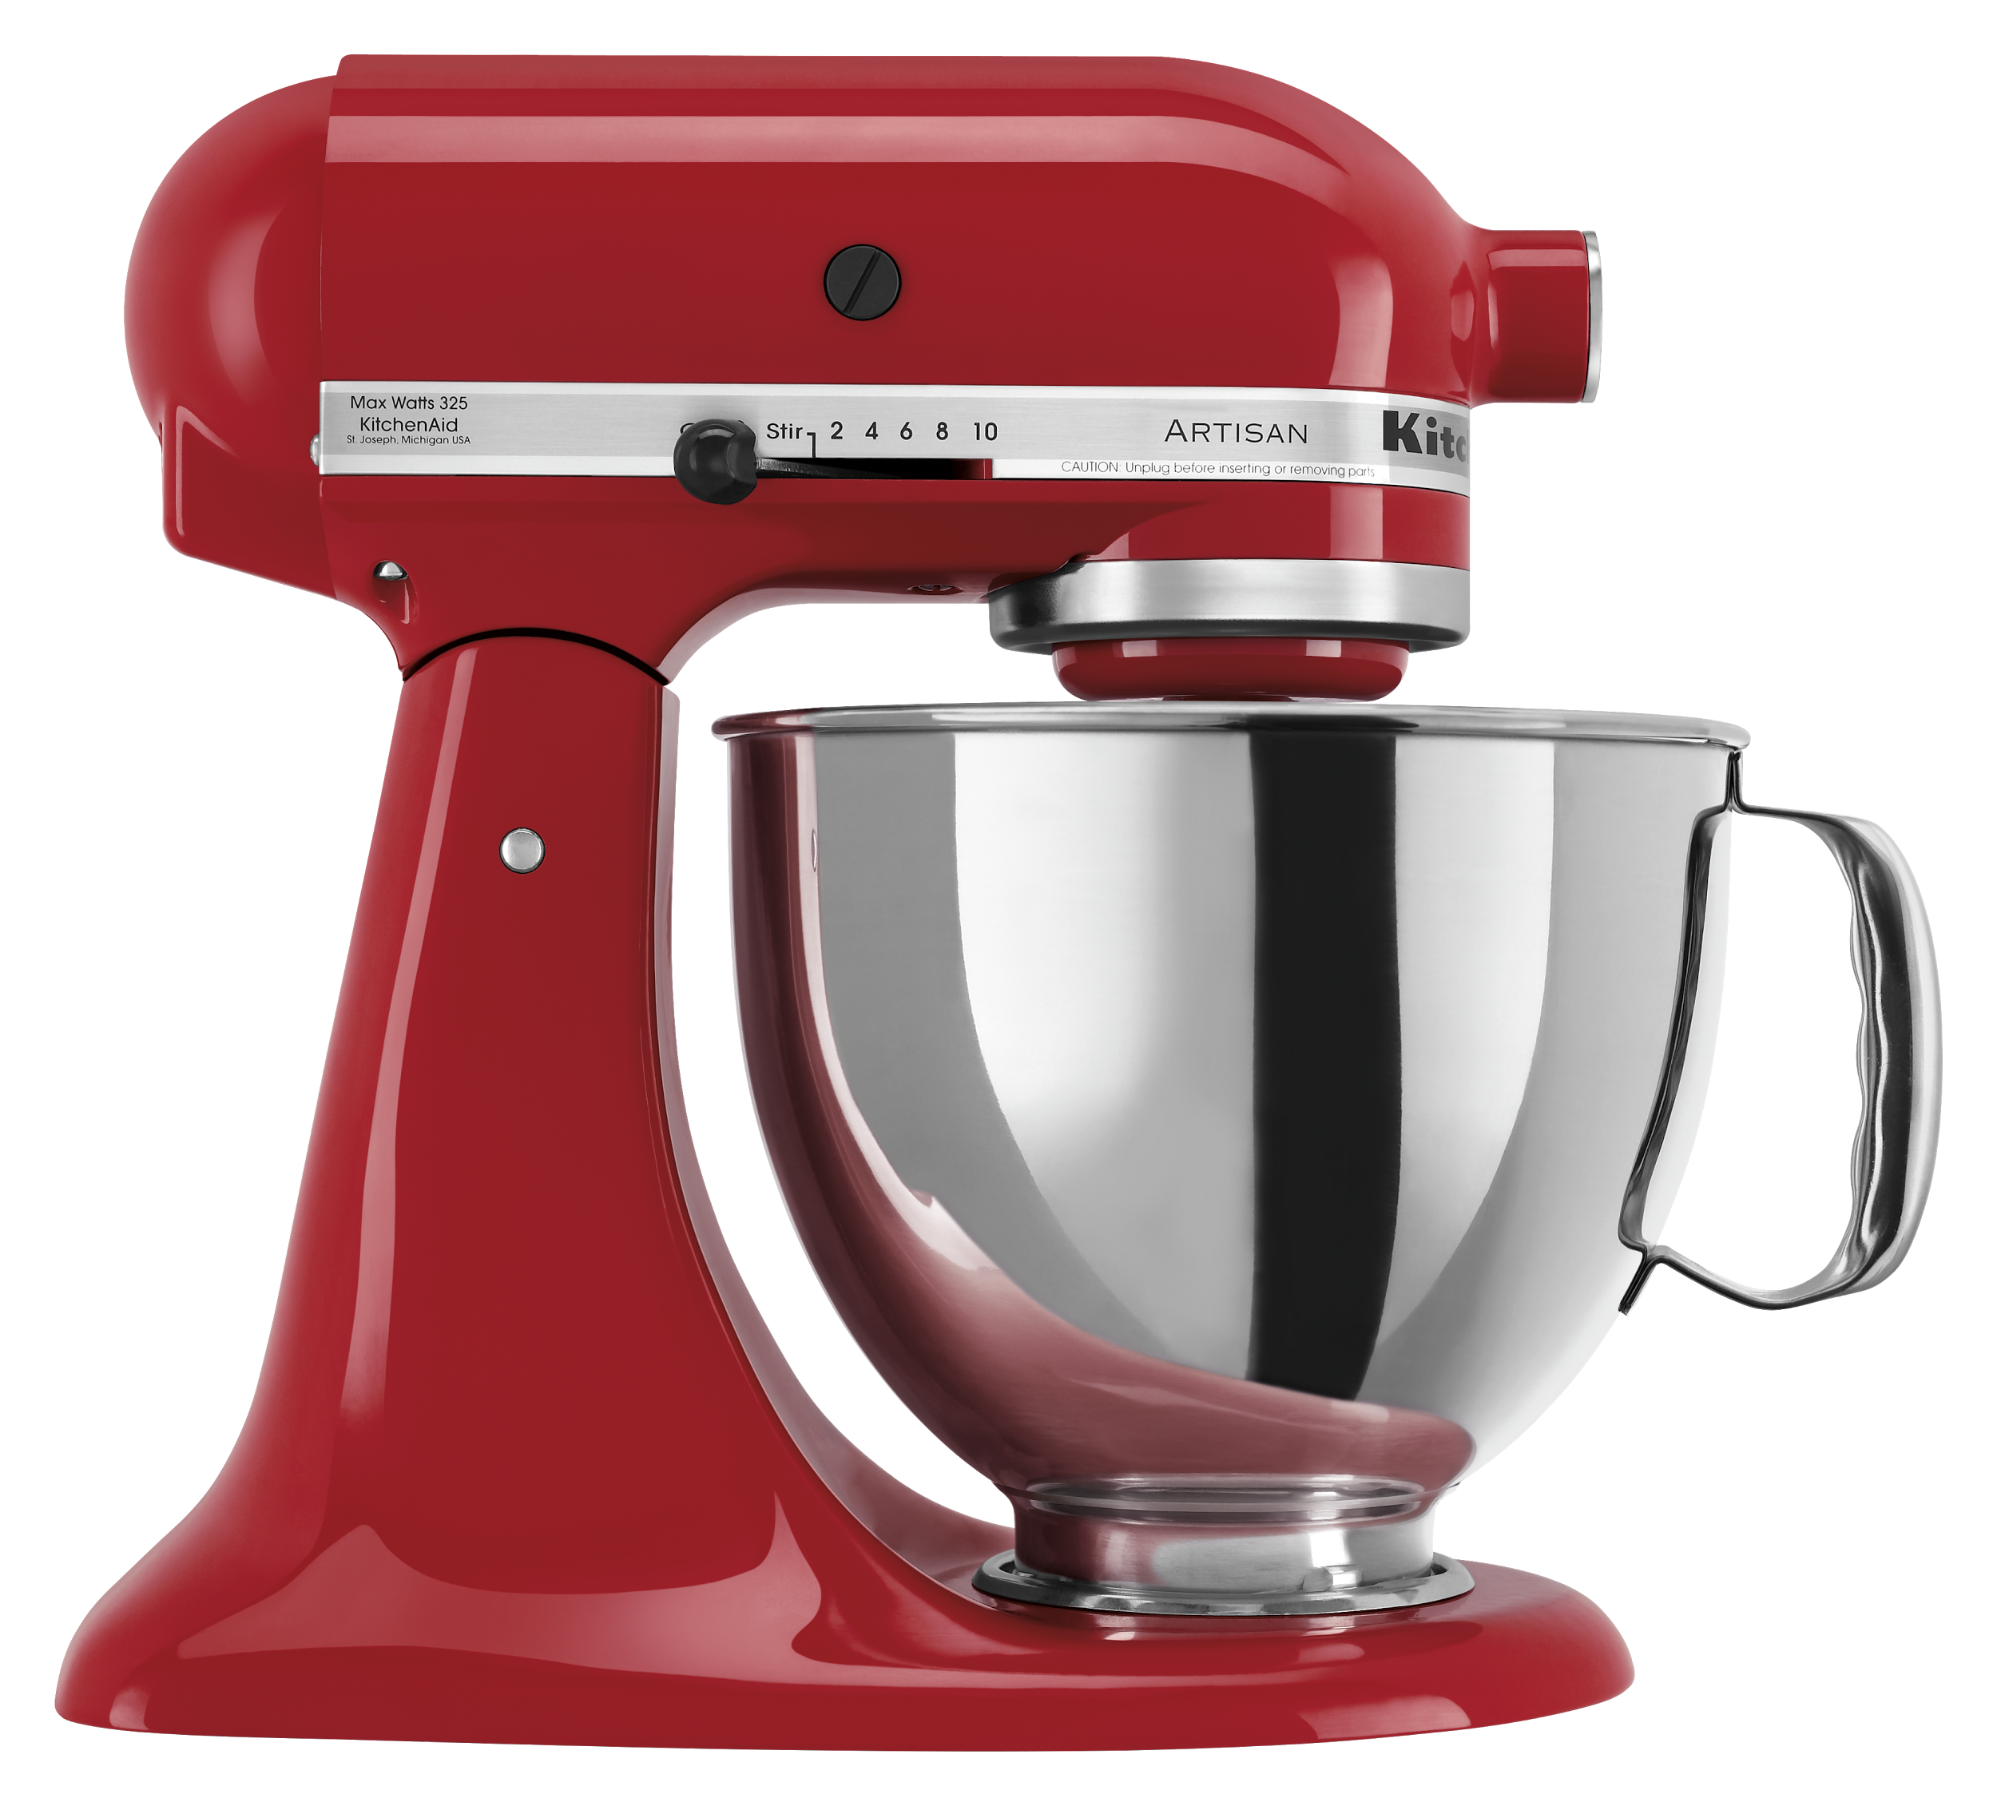
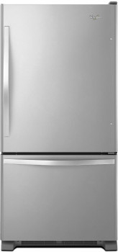
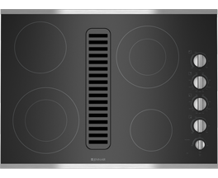
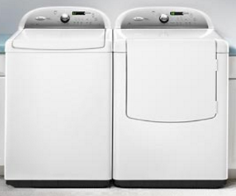
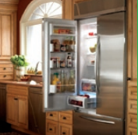
A LEGACY OF INNOVATION…
1911
1st Electric
Wringer Washer
1949
1st Side-by-Side
Refrigerator
1967
1st Countertop
Microwave
1999
1st Large Capacity Front-Load Washer
2006
1st FDBM with Ice and Water on Door
2008
1st Top-Load Pair
with Steam Cycle
1920
1940
1960
1980
2000
1910
1930
1950
1970
1990
2010
1919
1st Stand Mixer
1957
1st Bottom Mount Refrigerator
1961
1st Self-Ventilated Cooktop
1998
1st Energy Efficient
Top-Load Washer
2006
1st French-Door Built-In Refrigerator
DCMME Conference / September 28, 2018

Slide 11
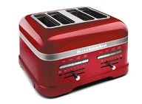
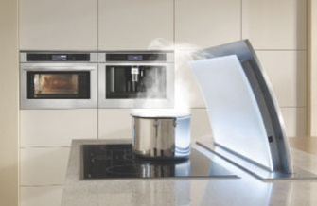
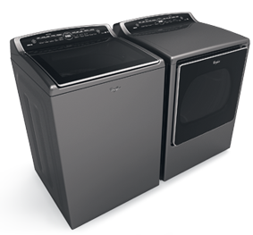
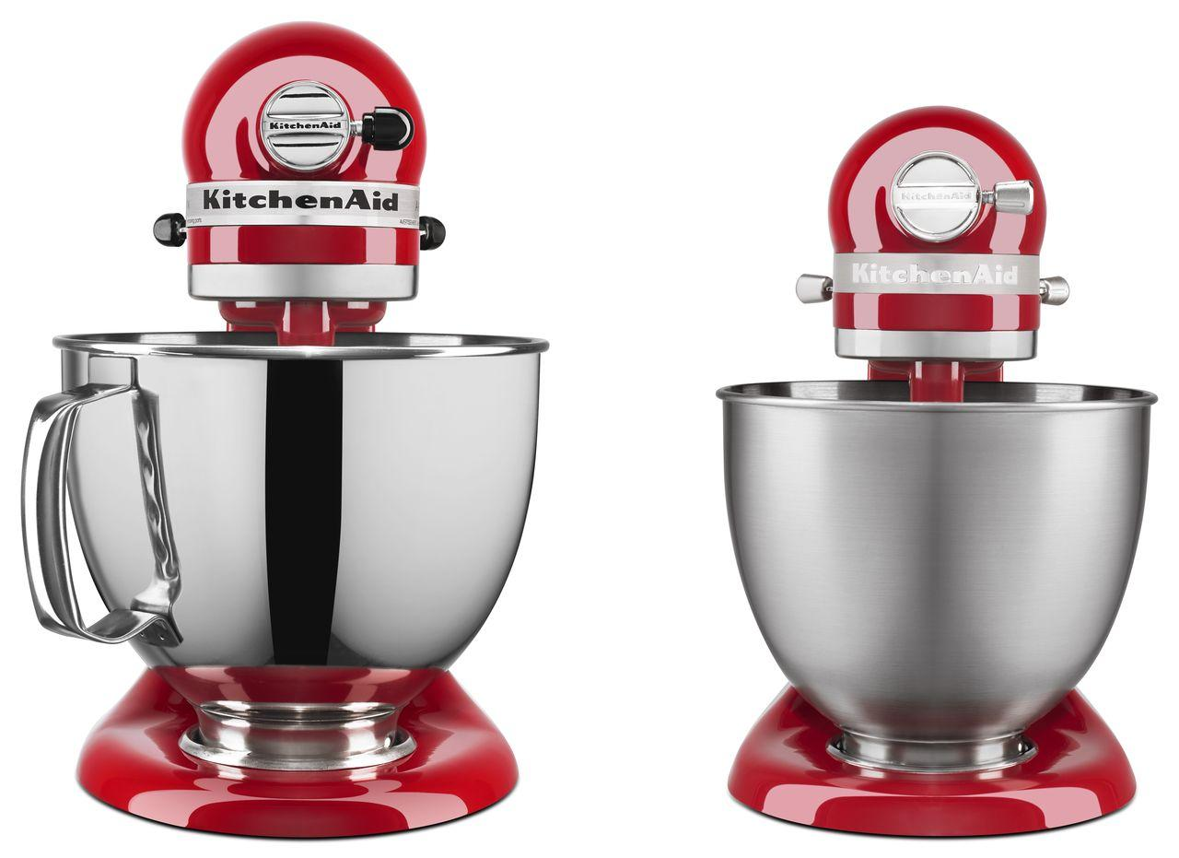
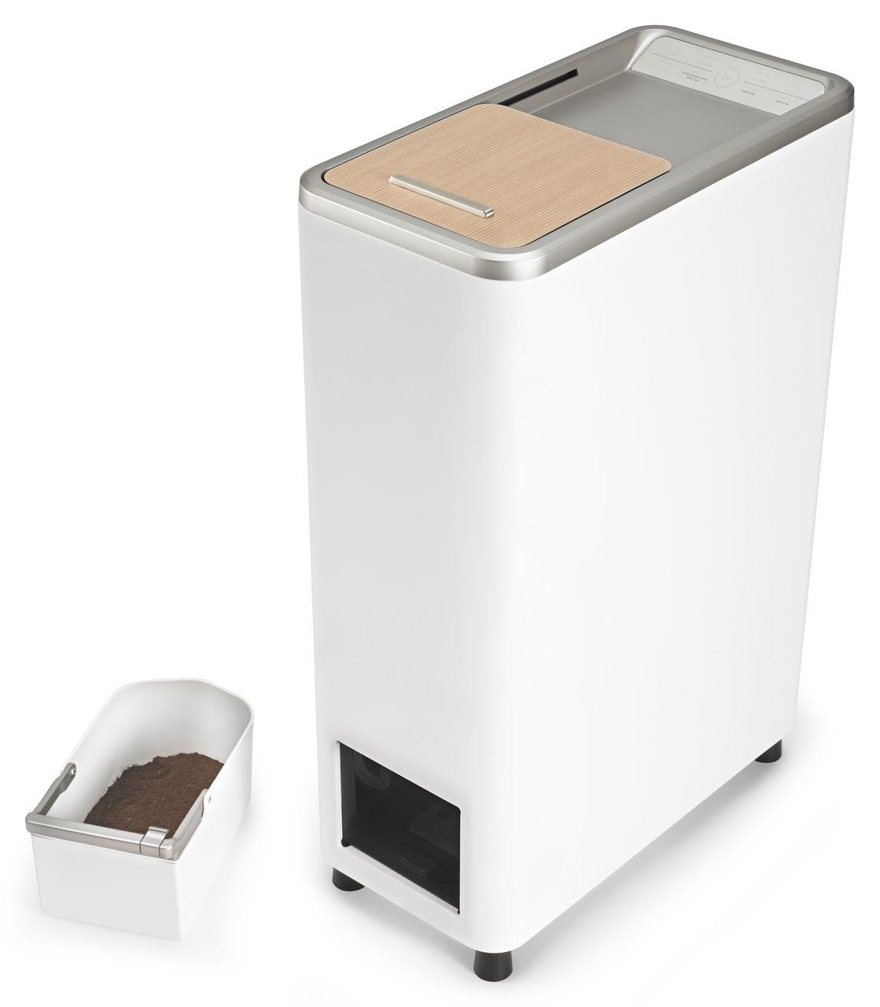
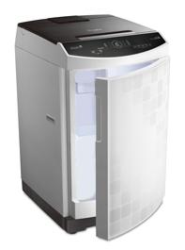
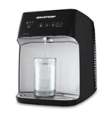
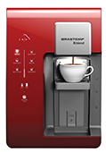
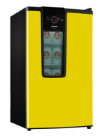
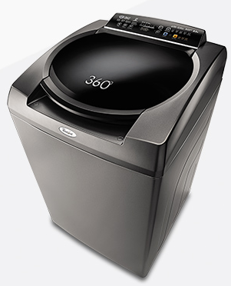
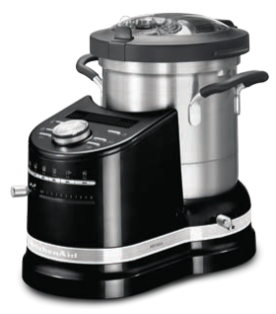
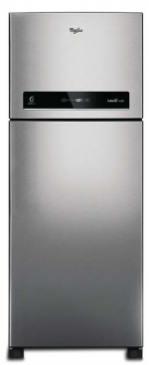
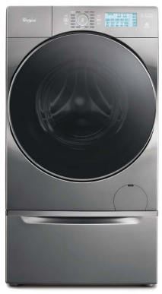
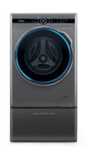
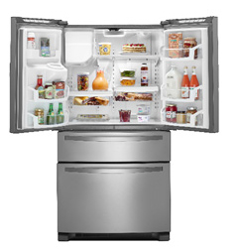
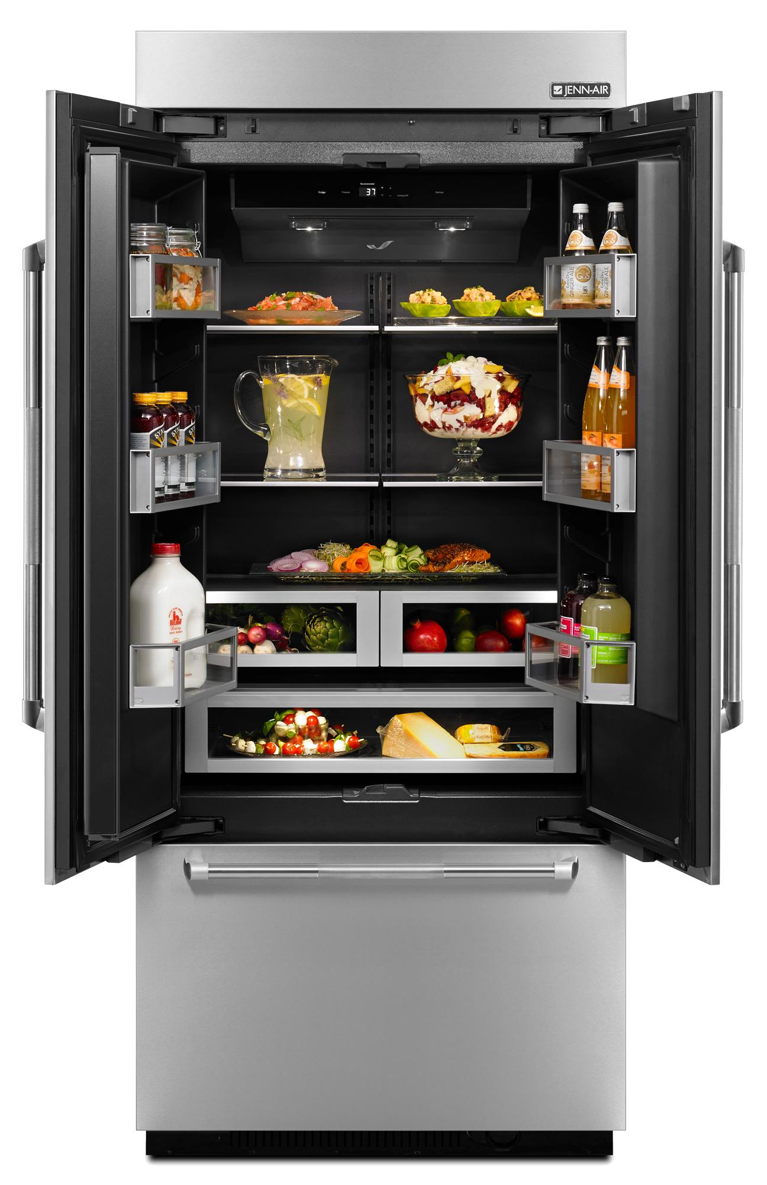
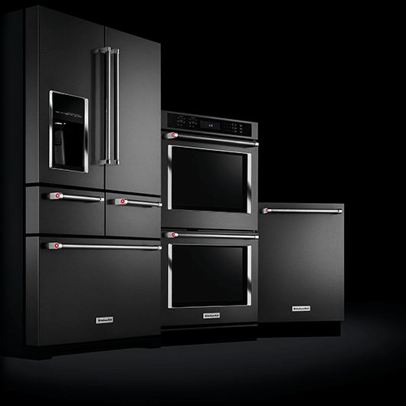
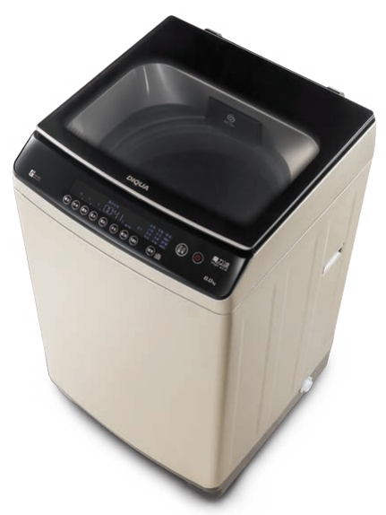
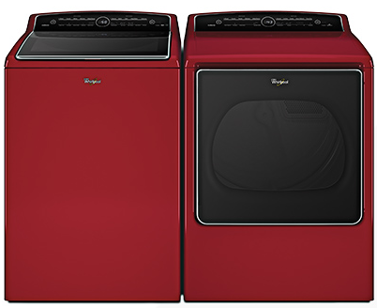
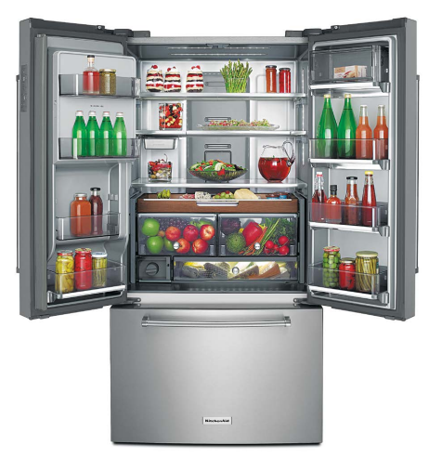
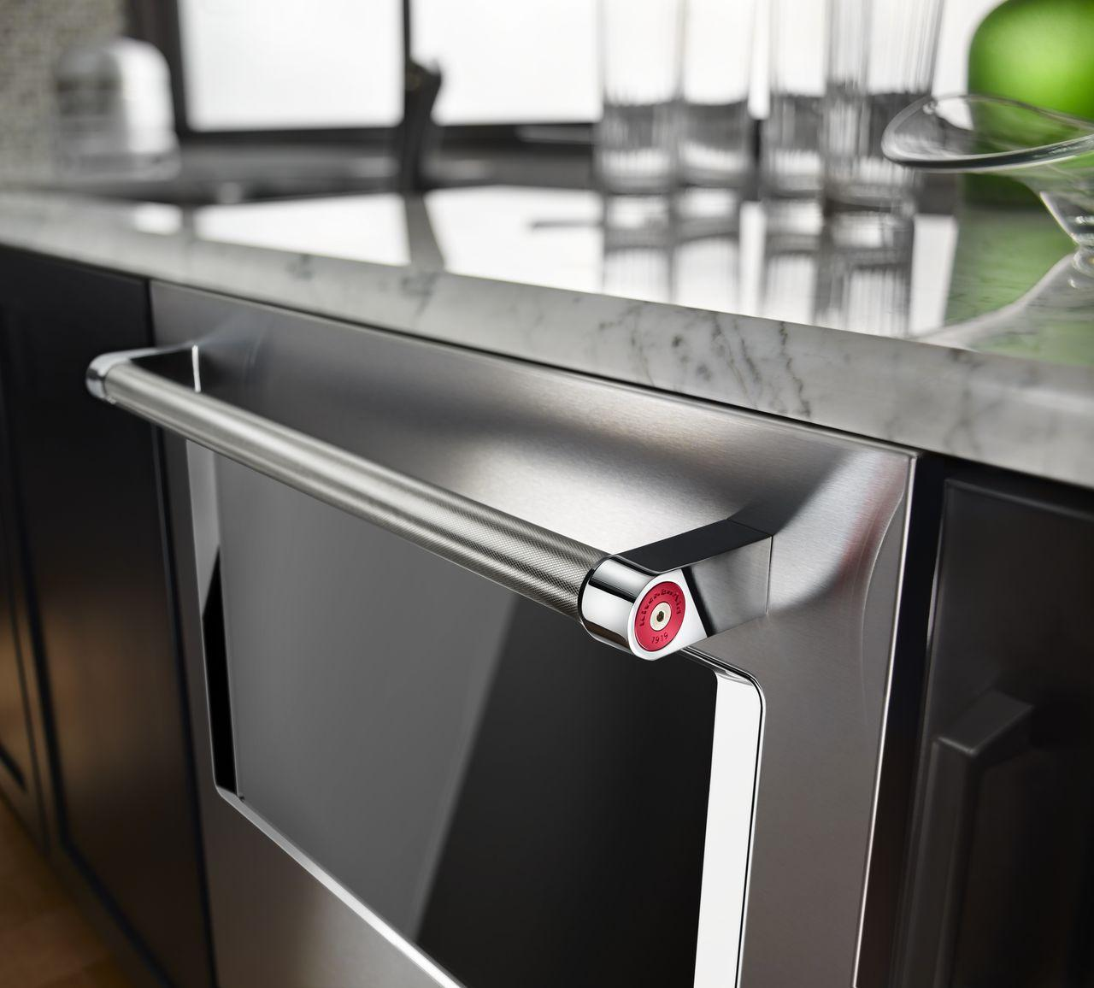
…WITH AN INCREASING CADENCE
2014
2015
2016
2017
Annual New Product Introductions
50
70
100
100+
OUR WORLD-CLASS INNOVATION PIPELINE CONTINUES TO ACCELERATE
DCMME Conference / September 28, 2018

Slide 12
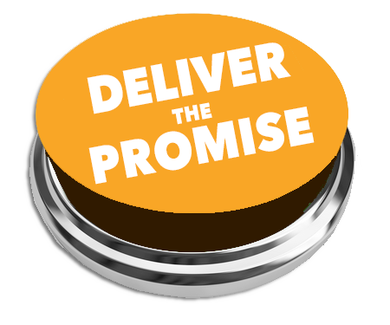
GLOBAL STRATEGIC AGENDA
Vision
The Best Branded Consumer Products...in Every Home Around the World
Instill a deep passion for our consumers that drives the right decisions and actions every day.
Make Whirlpool the preferred choice for trade customers to buy, sell and recommend our brands.
Do what we say we’re going to do. For all our stakeholders.
Mission
Create Demand and Earn Trust Every Day
Global Imperatives
Strategy
Deliver product leadership
Re-define what “product” is
Win the (digital) consumer journey
Reinvent our value chain
Product Leadership
Brand Leadership
Operating Excellence
People Excellence
Manufacturing 2020
Values
Respect • Integrity • Diversity & Inclusion Teamwork • Spirit of Winning
DCMME Conference / September 28, 2018

Slide 13
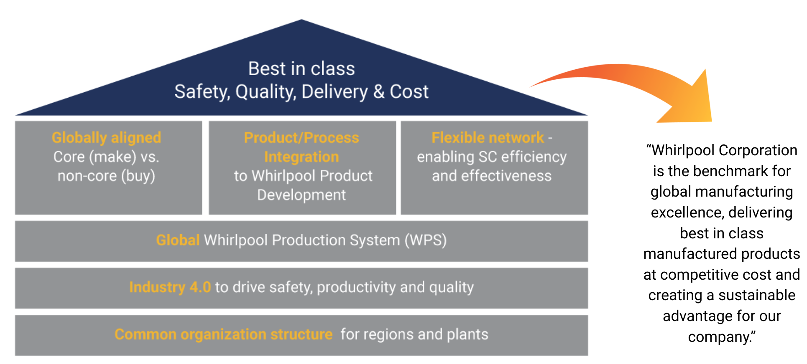
MANUFACTURING 2020 STRATEGY
DCMME Conference / September 28, 2018
Notes:
WPS evolution will lead to ONE global Whirlpool production system based on the World Class Manufacturing methodology
Industry 4.0 is targeting nine prioritized technology solutions based on financial potential and global scalability (Cleveland and Poprad pilot plants with concrete use cases)
End state will revolve around how manufacturing helps Deliver Product Leadership through world class processes and systems in order to serve as a competitive advantage for the company

Slide 14
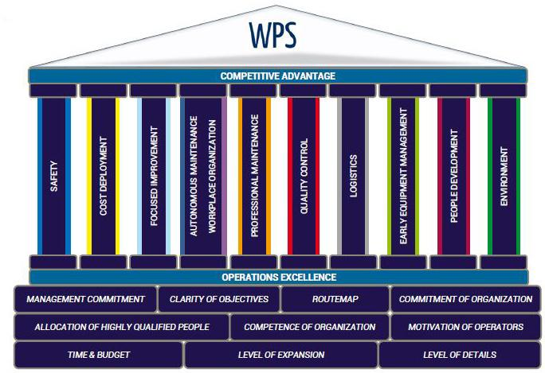
GLOBAL WPS EVOLUTION IS UNDERWAY
Implementing the World Class Manufacturing (WCM) methodology to drive the evolution of WPS
Translating the 10 technical and 10 managerial pillars into a standard global methodology for Whirlpool Corporation
GLOBAL WPS EVOLUTION USING WCM METHODOLOGY
DCMME Conference / September 28, 2018

Slide 15
WORLD CLASS MANUFACTURING (WCM)
Our global Whirlpool Production System is based on the rigor and discipline of WCM:
Awareness of safety is an essential value
The voice of the customer is heard in the shop floor
Leaders have a passion for standards
No form of waste is accepted…ZERO
Methods are applied strictly and tenaciously
All faults are made visible and treated as opportunities
People involvement is the driving force of change
DCMME Conference / September 28, 2018

Slide 16
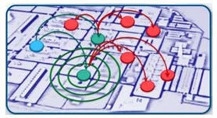
WCM APPROACH
Mastery in MODEL AREAS using a disciplined 7 STEP process
Model areas are determined by loss analysis
Expansion after demonstrated competency and standards are established
DISCIPLINED APPROACH TO GO DEEP BEFORE WIDE
DCMME Conference / September 28, 2018

Slide 17
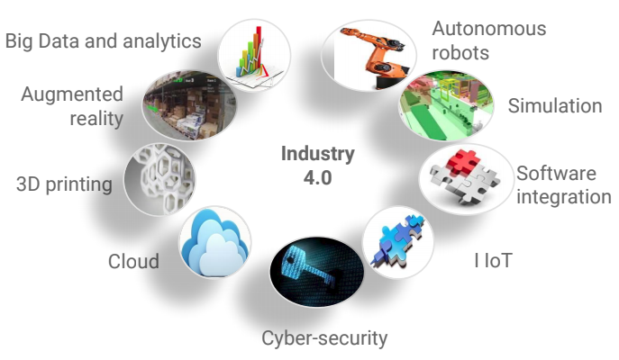
INDUSTRY 4.0 - MEDIA BUZZ OR REAL SUBSTANCE?
“The speed of current breakthroughs has no historical precedent. Compared with previous industrial revolutions, the fourth is evolving at an exponential rather than a linear pace”. - WEF Chairman at Forum in Davos
"The technology is like the force in Star Wars, the results depend on how you use it.” - CEO of Mahindra Group about I4.0
Fourth industrial revolution “..35% of all workers in the UK, and 47% of those in the US, are at risk of being displaced by technology over the next 20 years.”
- The Guardian
PRIORITIZING THE RIGHT I4.0 TECHNOLOGIES TO SOLVE THE GREATEST BUSINESS NEEDS
DCMME Conference / September 28, 2018
Notes:
Focuses on applying various technologies to improve our safety, productivity and quality.
Industry 4.0 refers to the way technology and automation come together to transform manufacturing.

Slide 18
INDUSTRY 4.0 TECHNOLOGY MODEL FACTORY WORK
I4.0 technology solutions 4 Tech Categories 9 Factory Use Cases
Automation
Collaborative
Material Handling- AGVs
Advanced Testing
New Testing Technologies
Data Visibility and Analytics
Shop Floor Visibility
Material Visibility
Quality Analytics
IIoT
Agile Mfg and Integrated
Product Production Systems
Automation
Automated Material Handling, Scheduling Integration - automated parts delivery & FG AGVs
Collaborative Robots - Rib Crack Detection
Advanced Testing
Advanced systems for quality testing - Cavity Width Measurement, Rib Depth
Data visibility and analytics
Machine monitoring, optimization - Connected Backshop, Cavity Line, Porcelain Booth
Quality visibility - Rib Depth / Crack Detection
Predictive quality analytics - Sares Machine Learning
Agile & Product/Production Int.
Late differentiation - Cavity Laser Piercing (Wave 2)
VIDEO: CLEVELAND MODEL FACTORY
DCMME Conference / September 28, 2018

