Slide 1
Getting Started with IoT
Lou Rives
President of Versa Tech Automation
Sept 28, 2018

Slide 2
Presentation Focus
Stay competitive through the capture of your factory data in RealTime
Planning for Implementing IoT
Realize Profits by measuring OEE
Share the data to drive continuous improvement

Slide 3
Data provides a competitive edge
Visualize Data as a by-product of your operation
You have already invested in creating it
Data can be ignored and provide no value
Data captured and analyzed can reduce cost
Your competition is implementing data collection

Slide 4
Use DATA to drive Improvements
Work Cell
Product
10101…
Data Output
Wasted Data
Work Cell
Product
Improvements
10101…
Data Output
Analyze

Slide 5
Planning for IoT

Slide 6
Business Data – Operational Data . IT + OT
Information Technology (IT) - all technologies that are necessary to manage the processing of information
Operational Technology (OT) - the controllers, software and sensors that are necessary for manufacturing processes
IoT = IT + OT

Slide 7
IoT - Internet of Things 1
Generally
The Internet of Things (IoT) is the network of devices
PCs, tablets, phones, vehicles, home appliances
The embedded electronics and application software
The connectivity which enables these things

Slide 8
Industrial Internet of Things
The Industrial (IoT) “IIoT” is the integration of automation, communications and networking in industrial environments
Reflect on the lack of Office connectivity of 1980s
Reflect on the lack of OT connectivity in 2018

Slide 9
IoT - Internet of Things 2
IT + OT convergence enables
More direct control and complete monitoring
Collecting Data from complex systems
Easier Data organization & analysis
Greater consistency of results
Improved recordkeeping for regulatory purposes
Access of the information from anywhere in the world

Slide 10
IoT Considerations 1
Ethernet Networks for OT
Control Equipment – PLC, HMI, Sensors
OT Software is Server / Client based
Educate your workforce
Engage Professional support
Security of Information – key importance

Slide 11
IoT Considerations 2
Security of Information – challenges
IT focus on rebooting systems to implement patches
OT focus is on limiting downtime
Software and Hardware protections
Antivirus - Managed Switches
Patching - Network Segregation
Revision Compatibility

Slide 12
IoT Considerations 3
Challenges should NOT prevent embracing IoT
Integrating information across IT and OT
Maximize your operations and communications
Decisions are Data-driven at all levels
Share Data in RealTime, Anywhere (Mobility)

Slide 13
How to Visualize your Plant for IOT \ ANSI / ISA-95 Standard
Developed with the objective to provide
Abstract models and standard terminologies
Standardizes the exchange of information
Bridges business systems and manufacturing operations systems
Defines Levels based on
Focus of Management Control
Timing of Data Transfer

Slide 14
Visualize your Plant
Level 4 Business Planning & Logistics
Level 3 Manufacturing Operations Management
Level 2 Manufacturing Control
Level 1 Sense & Manipulate
Level 0 Production Process

Slide 15
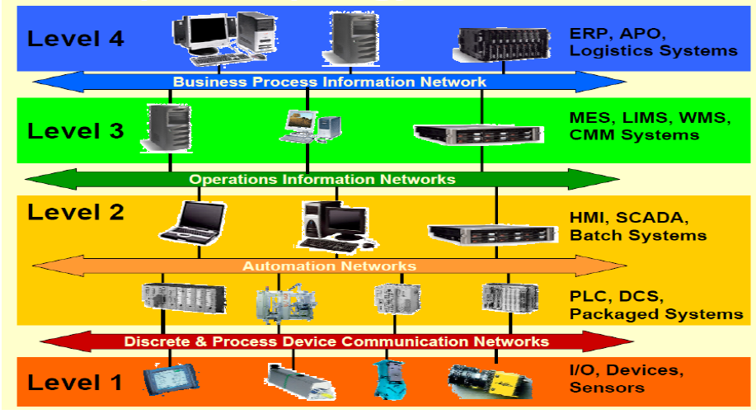
ANSI / ISA-95 Standard Levels
Tampere University of Technology
Dazhuang HE may 2012

Slide 16
A Starting Point to Using DATA Overall Equipment Effectiveness (OEE)

Slide 17
Overall Equipment Effectiveness (OEE)
Standard for measuring manufacturing productivity
OEE = Availability X Performance X Quality
Reduces costs by utilizing existing equipment more efficiently
Increases Capacity
Decreases Cost
Defers capital expenditures

Slide 18
OEE 1
Measuring OEE is a manufacturing best practice
OEE is the single best metric for identifying
Production losses
Benchmarking progress
Improving the productivity by eliminating waste
Determine where to make improvements & capital investments
Improve scheduling, training, equipment PMs

Slide 19
OEE 2
Perfect OEE of 100% is almost impossible
85% is World Class (90% x 95% x 99%)
60% should be an early, low target (80% x 80% x 95%)
40% not unusual if you are just starting to track OEE
(70% x 65% x 90%)

Slide 20
How to Implement OEE 1
Start with a machine, a work cell or a production line
Measure either Manually or Automatically
Automated Data Collection
Is very cost effective
More accurate
More timely reporting

Slide 21
How to Implement OEE 2
Data to capture is rather simple
Good Counts
Ideal Cycle Time {Design Capacity or by a Time Study}
Planned Production {Decide what to exclude}
Breaks, Changeovers
Stop Reasons {Reason Codes}
Determine Reason Codes Root Causes
Faults, blocked or starved, procedures , changeovers

Slide 22
How to Implement OEE 3
Automated Data Collection
PLC connected via EtherNet/IP to OT Server
Example Software Application
Rockwell FactoryTalk Metrics
Project Cost can start at about than $ 10 K
Generally about $ 3 K per work cell

Slide 23
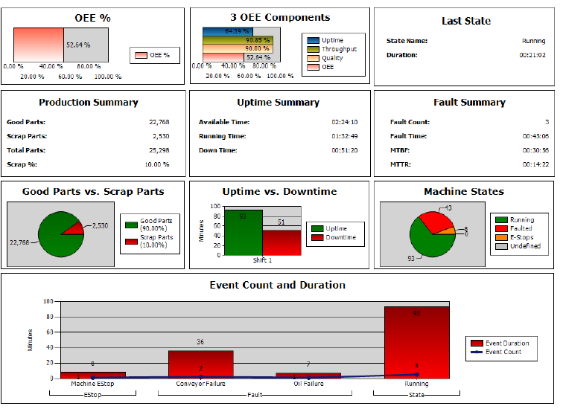
Example OEE Reports

Slide 24
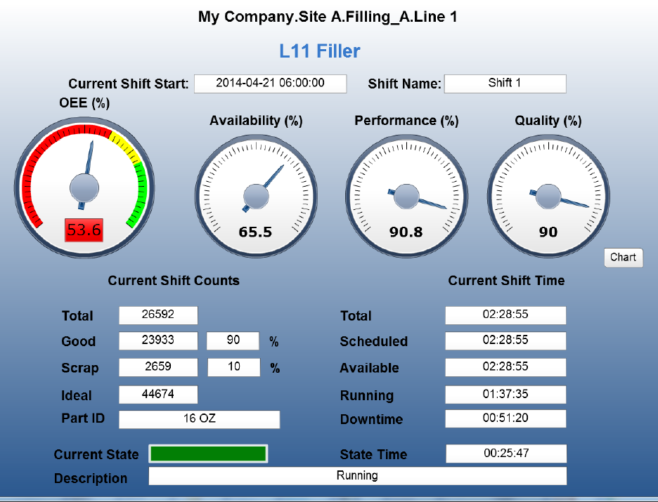
Example OEE Dashboards

Slide 25
Share the Data
Visualization of the data to drive continuous improvement
Team Members receive RealTime information
Dashboards in Control Rooms, Production Areas, and Maintenance Areas
Web-browser on PC, Tablet, Phones
Emails with Daily Production data and visual attachments

Slide 26
Sharing Data

Slide 27
OEE is just a starting point
Other example IoT implementations
Data Historians for Trending and Track &Trace
Server / Client HMI systems for distributive control and mobility
Thin Managers and Thin Clients
MES to model and enforce Processes, Performance, Quality

Slide 28
Thank you Questions

