Slide 1
A Blockchain Primer
Developed for WHIN
Wabash Heartland Innovation Network
Arun Gupta
September 28, 2018

Slide 2
Agenda
Use case – before and after
What is blockchain?
Why is it important?
How does blockchain work?
What issues is blockchain trying to solve and how?
When should I use blockchain
Use cases in supply chain, IoT, and agriculture

Slide 3
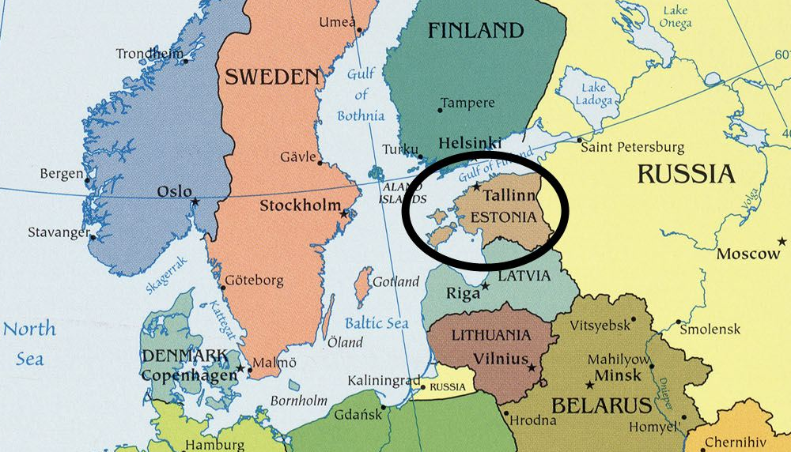
Use case – Before Blockchain
Primarily a document that provides proof of citizenship and acts as a travel document.
Can act as an identity document for certain transactions

Slide 4
Use case – With Blockchain
Embedded chip with 2048 bit encryption
Definitive proof of ID in an electronic environment.
Examples of current uses in Estonia:
Legal travel ID for Estonian citizens travelling within the EU
National health insurance card
Electronic banking
Digital signatures (5 days saved per year)
i-Voting
Medical records, e-Prescriptions, submit tax claims, etc.
https://e-estonia.com/solutions/e-identity/id-card/
E-identity
98% Estonians have e-id card
500 M digital signatures

Slide 5
What is Blockchain?
An immutable distributed ledger
Technology for untrusted parties to reach consensus on transactions through shared and distributed ledgers
Efficient processes at lower cost through smart contracts and secure & private transactions

Slide 6
Why is Blockchain Important? 1
Well suited for digital transactions without intermediaries through
Consensus – Mark valid transactions as complete
Immutability – Ensure transactions marked as complete cannot be changed
Provenance – ability to trace genealogy of a transaction from start to finish
“Update Only” property provides
Transparency to transactions
Visibility to entire transaction history

Slide 7
Why is Blockchain Important? 2
Efficient processes at lower cost through
Smart contracts
Secure and private transactions
Transparency to all transactions

Slide 8
CARTOON

Slide 9
Transactions
Single party reporting an event
Two parties with no currency exchange
Two parties, with currency exchange

Slide 10
How Does Blockchain Work?
Two party
Currency involved
Consensus
Immutability
Provenance

Slide 11
What Issues is Blockchain Addressing? 1
Efficiency – multiple versions of a transaction, immediate synchronization of steps to allow instantaneous visibility
Cost – duplication, intermediary entities, reduced need for intensive resources and oversight
Vulnerability – central system can be compromised due to fraud, cyber attack or simple mistake
Security – advanced encryption protects data, makes it unalterable, and improves transparency

Slide 12
What Issues is Blockchain Addressing? 2
Identity – Proof that someone is who they she/he is, or goods or assets are exactly as represented. Violation immediately verifiable
Trust – each party can only see what is relevant to him/her, and participants agree whether a transaction is valid or not
Verification – every step (i.e., block) is a process is based on one previous block in the chain and cannot be altered

Slide 13
What Issues is Blockchain Addressing? 3
Paying for things with your face
Streamlining interactions among shoppers, retailers and brands
Linking content across computers, tablets and phones
Ranking apps by their value
Aligning creativity and recognition for content creators
Improving payments for artists on Spotify and Pandora
Online piracy
Improving the technology of the Russian gas industry
A blockchain equivalent of Amazon, Groupon and Craigslist
Too many non-value-added costs
Unregulated prison economies
Standardizing the value of advertisements
Advertising not transparent enough
Old real estate practices
Free public information from silos
Speeding the rendering of animated movies
Selling items for crypto instead of regular money
Borders
Man-in-the-middle hacks
Security sacrifices that come with innovation
Scams, fraud and counterfeits
Tools to build decentralized apps
Blockchain infrastructure
Removing barriers separating blockchains
Safety in buying and selling blockchain tokens
Improving privacy in online file storage
ICO projects could benefit from the “wisdom of the crowd”
Improving privacy of blockchain
Decentralized database for decentralized technologies
Improving trust and confidence in blockchain system
More cohesive user experiences across blockchain and the cloud
Democratizing gold trading
Giving investors more control of their assets
Simplifying the cryptocurrency transaction process
Trading indexes as tokens
Improving crypto safekeeping solutions
Simplifying ICO investment, trading and cryptocurrency
Improving institutional-grade crypto asset management
“Painstakingly slow” manual crypto wallet process
More open global markets
Easier way to invest in real estate
Easier way to invest in Swiss real estate
Easier way to combine smart contracts with crowdfunded home loans
Easier way to borrow against crypto holdings
Identifying and verifying users in online dating
Improving traditional banking services for crypto world
Cryptocurrency based on Game Theory, IBM’s Watson, and other theories
Better social network + blockchain + AI + human touch
Improving content streaming on the blockchain
Supply chain transparency
Increasing public sector trust of cryptocurrencies
Education around blockchain technology
Blockchain not mainstream enough
Crowdsourcing for legal dispute resolution
Securing financial contracts
Paper
Automation
Control of personal data
Control of personal credit data
No way to spend crypto
Advertising for extended reality environments
Human suffering
Security for luxury watches
Authenticity in cannabis sales
Crypto rewards for cannabis-focused social media site
Crypto payments for rating cryptoassets
Crypto payments for taking surveys, watching videos and clicking links
Crypto rewards for video game skills
Crypto rewards for time spent playing video games
Buying, selling and trading your social media friends
Crypto rewards for social media sharing
Free mobile data for watching ads
Crypto rewards for watching entertainment content
Gold-backed cryptocurrency
Crypto-backed gold
Metals-backed cryptocurrency
Precious metals-based cryptocurrency
“Tokenizing” real world items
Nashville apartment buildings
Monaco real estate
Financial infrastructure for trading within video games
Checking ID for purchases like alcohol
“Uber for alcohol” on blockchain
Inefficiencies in cargo delivery
Branded tokens for merchants to reward customers
Fraud and corruption among non-profits
Better transparency at non-profits
Better transparency around impact investing
Bitcoin mining uses too much energy
Home appliances mining for bitcoin while not in use
Bitcoin mining using hydropower
Large corporations’ carbon footprints
“Decarbonizing” electricity grids
Climate change
Trust in governments
Trust in corporations
Trust in social networks
Trust in media
Universal billing system for travel industry
Decentralized Uber and Lyft
Online gambling not fair
Online gambling sites take commission
Helping retailers hurt by Amazon
Online retail fraud
Bots with nefarious intent
Skynet
People not taking their medicine
Device storage that could be used for bitcoin mining
Insurance bureaucracy
Electronic health record accessibility
Health record storage security
Health record portability
Marine insurance risk
Cancer
Earning money on personal data
Pensions
The burden of car ownership
Inability to buy anything with cryptocurrency
Better marketplaces for nautical shipping services
Better ways to advertise to your friends
Better ways to trade forex with your friends
Ownership shares in ancient sunken treasures
Poverty
Complying with Know Your Customer laws
Complying with Anti-Money-Laundering laws
Complying with securities laws in token sales
Censorship
A use for QR codes
Rewards for buying alcohol by subscription
Tracing water supplies
Dearth of emergency responders
High cost of medical information
Improved digital identity authentication
Managing real estate workflow
International real estate purchases
Physical branches for crypto banking
Physical branches for crypto exchanges
Private equity
Venture capital
AIDS, also online sales of classic Japanese domestic cars
Efficiency and transparency at nonprofits
Incorporating local preferences in decentralized banking options
Boosting sales for local businesses
A digital-only investment bank
Containers to transport sensitive pharmaceuticals and food
Protecting consumer information on mobile
Helping mobile phone users monetize their data
Not enough interconnection in the world
Complexity and risk in the crypto market
Expensive AI research
Counterfeit goods
Connecting “innovation players” and “knowledge holders”
Movie industry’s slow and opaque accounting practices
Global supply chain’s $9 trillion cash flow issue
Trust in the global supply chain
Economic crisis
Cash flow problems at small and medium-sized businesses
Improving the use of data in the transportation and logistics industries
Poverty among African farmers
Transparency in the food supply chain
Ad fraud
Fake news
False news
Settling payments faster
Speeding transactions
The unbanked
The underbanked
The bidding process in art and collectibles markets
Assessing the value of collectibles
Poverty
Cancer
Human suffering
Fake news
Climate Change

Slide 14
What Issues is Blockchain Addressing? 4
Paying for things with your face
Streamlining interactions among shoppers, retailers and brands
Linking content across computers, tablets and phones
Ranking apps by their value
Aligning creativity and recognition for content creators
Improving payments for artists on Spotify and Pandora
Online piracy
Improving the technology of the Russian gas industry
A blockchain equivalent of Amazon, Groupon and Craigslist
Too many non-value-added costs
Unregulated prison economies
Standardizing the value of advertisements
Advertising not transparent enough
Old real estate practices
Free public information from silos
Speeding the rendering of animated movies
Selling items for crypto instead of regular money
Borders
Man-in-the-middle hacks
Security sacrifices that come with innovation
Scams, fraud and counterfeits
Tools to build decentralized apps
Blockchain infrastructure
Removing barriers separating blockchains
Safety in buying and selling blockchain tokens
Improving privacy in online file storage
ICO projects could benefit from the “wisdom of the crowd”
Improving privacy of blockchain
Decentralized database for decentralized technologies
Improving trust and confidence in blockchain system
More cohesive user experiences across blockchain and the cloud
Democratizing gold trading
Giving investors more control of their assets
Simplifying the cryptocurrency transaction process
Trading indexes as tokens
Improving crypto safekeeping solutions
Simplifying ICO investment, trading and cryptocurrency
Improving institutional-grade crypto asset management
“Painstakingly slow” manual crypto wallet process
More open global markets
Easier way to invest in real estate
Easier way to invest in Swiss real estate
Easier way to combine smart contracts with crowdfunded home loans
Easier way to borrow against crypto holdings
Identifying and verifying users in online dating
Improving traditional banking services for crypto world
Cryptocurrency based on Game Theory, IBM’s Watson, and other theories
Better social network + blockchain + AI + human touch
Improving content streaming on the blockchain
Supply chain transparency
Increasing public sector trust of cryptocurrencies
Education around blockchain technology
Blockchain not mainstream enough
Crowdsourcing for legal dispute resolution
Securing financial contracts
Paper
Automation
Control of personal data
Control of personal credit data
No way to spend crypto
Advertising for extended reality environments
Human suffering
Security for luxury watches
Authenticity in cannabis sales
Crypto rewards for cannabis-focused social media site
Crypto payments for rating cryptoassets
Crypto payments for taking surveys, watching videos and clicking links
Crypto rewards for video game skills
Crypto rewards for time spent playing video games
Buying, selling and trading your social media friends
Crypto rewards for social media sharing
Free mobile data for watching ads
Crypto rewards for watching entertainment content
Gold-backed cryptocurrency
Crypto-backed gold
Metals-backed cryptocurrency
Precious metals-based cryptocurrency
“Tokenizing” real world items
Nashville apartment buildings
Monaco real estate
Financial infrastructure for trading within video games
Checking ID for purchases like alcohol
“Uber for alcohol” on blockchain
Inefficiencies in cargo delivery
Branded tokens for merchants to reward customers
Fraud and corruption among non-profits
Better transparency at non-profits
Better transparency around impact investing
Bitcoin mining uses too much energy
Home appliances mining for bitcoin while not in use
Bitcoin mining using hydropower
Large corporations’ carbon footprints
“Decarbonizing” electricity grids
Climate change
Trust in governments
Trust in corporations
Trust in social networks
Trust in media
Universal billing system for travel industry
Decentralized Uber and Lyft
Online gambling not fair
Online gambling sites take commission
Helping retailers hurt by Amazon
Online retail fraud
Bots with nefarious intent
Skynet
People not taking their medicine
Device storage that could be used for bitcoin mining
Insurance bureaucracy
Electronic health record accessibility
Health record storage security
Health record portability
Marine insurance risk
Cancer
Earning money on personal data
Pensions
The burden of car ownership
Inability to buy anything with cryptocurrency
Better marketplaces for nautical shipping services
Better ways to advertise to your friends
Better ways to trade forex with your friends
Ownership shares in ancient sunken treasures
Poverty
Complying with Know Your Customer laws
Complying with Anti-Money-Laundering laws
Complying with securities laws in token sales
Censorship
A use for QR codes
Rewards for buying alcohol by subscription
Tracing water supplies
Dearth of emergency responders
High cost of medical information
Improved digital identity authentication
Managing real estate workflow
International real estate purchases
Physical branches for crypto banking
Physical branches for crypto exchanges
Private equity
Venture capital
AIDS, also online sales of classic Japanese domestic cars
Efficiency and transparency at nonprofits
Incorporating local preferences in decentralized banking options
Boosting sales for local businesses
A digital-only investment bank
Containers to transport sensitive pharmaceuticals and food
Protecting consumer information on mobile
Helping mobile phone users monetize their data
Not enough interconnection in the world
Complexity and risk in the crypto market
Expensive AI research
Counterfeit goods
Connecting “innovation players” and “knowledge holders”
Movie industry’s slow and opaque accounting practices
Global supply chain’s $9 trillion cash flow issue
Trust in the global supply chain
Economic crisis
Cash flow problems at small and medium-sized businesses
Improving the use of data in the transportation and logistics industries
Poverty among African farmers
Transparency in the food supply chain
Ad fraud
Fake news
False news
Settling payments faster
Speeding transactions
The unbanked
The underbanked
The bidding process in art and collectibles markets
Assessing the value of collectibles
Scams & Fraud
Supply chain transparency
Food traceability
Health record portability
Control of personal data

Slide 15
Should I use a Blockchain? What Type?
Yes
Save data?
No
Yes
Multiple “writers”?
No
No
Yes
Untrusted unknown writers?
No
No
Yes
Rely on trusted 3rd party?
No
No
No
No need for access control, immutability over efficiency, public transactions?
No
Yes
Multiple party consensus required?
Public
Private
Consortium

Slide 16
Use Cases – Supply Chain
Minimize fraud and errors
Efficient contracts and payments embedded in smart contracts
Improved visibility, velocity, variety
Reduce intermediaries (e.g., brokers in the logistics pipeline)
Increase trust between trading partners
Improve inventory management AND MANY MORE

Slide 17
Use Cases – Internet of Things
Product identity – supply chain & compliance, on-demand asset sharing network, IoT network management
Product transactions – on-demand asset sharing network, end user authentication,
Product interactions – immutable method to centralize interactions, events, and updates

Slide 18
Use Cases – Agriculture
Traceability – from farm to table
Verifiability of organic produce and seed
Quality control
Precision farming and resource management

Slide 19
Questions?

