Slide 1
Speaker: John Funcheon
John Funcheon
President, Kokusai Inc.

Slide 2
TECHNOLOGY

Slide 3
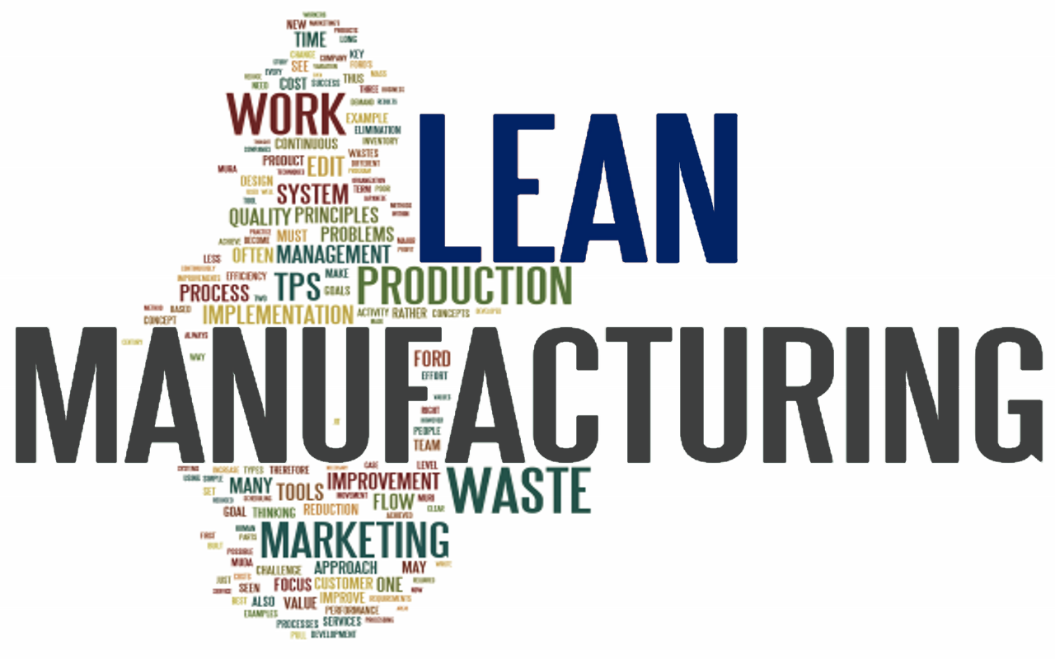
Main 1
Sub

Slide 4
Lean Concepts
Product Standardization
Minimize Inventory – raw, WIP, and final
Point of usage storage for Parts
Kan-Ban Pull Systems and simplified purchasing
Outsource non-core competencies – focus on core
Focus on and invest in production – start with customer/products
Continuous quality improvement and waste reduction
Mistake proofing
Involve people throughout the process

Slide 5
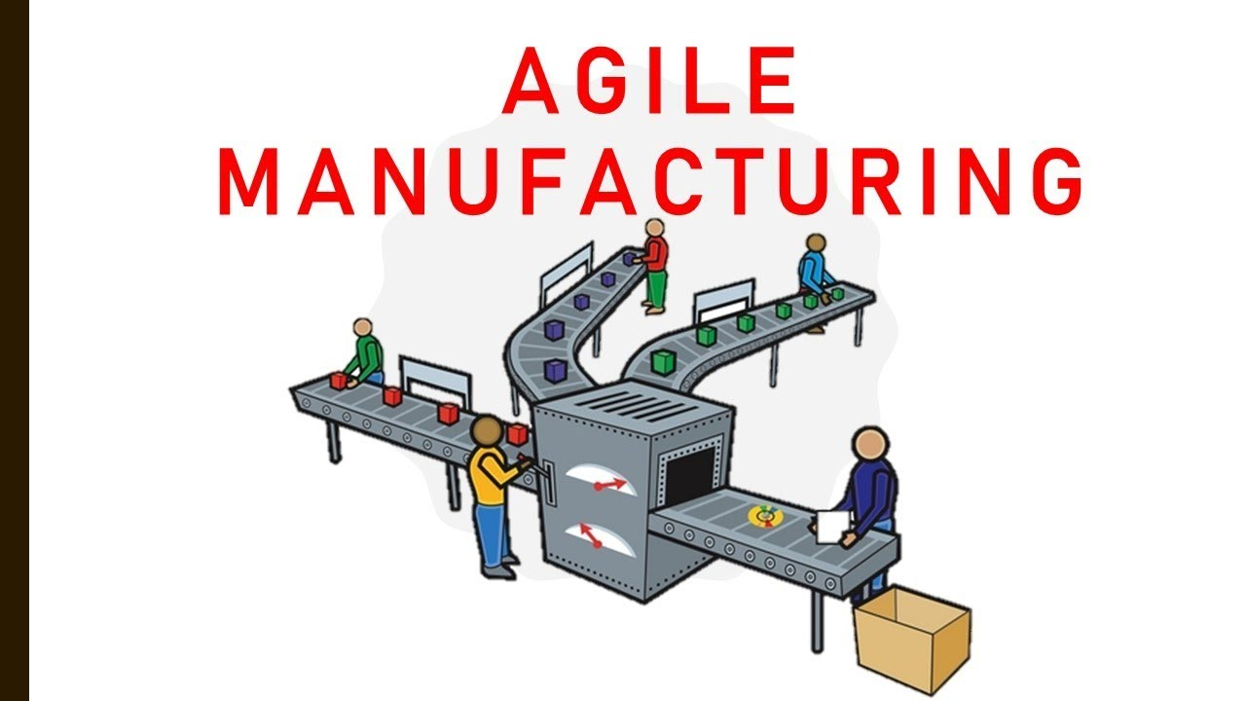
Main 2
Sub

Slide 6
Agile Concepts
Respond to shifting customer demands quickly
Design Production processes to be changed rapidly using existing equipment, tools, labor and raw materials to create custom products quickly.
Information systems shared by the marketing/sales, design and production departments that provide up-to-date information on the resources available for use and redesign at any given time.

Slide 7
Similarities:
Lean and Agile manufacturing are both ultimately focused on increasing business sustainability in high-cost manufacturing operations.
Both are answers to challenges faced by historical manufacturers.
Both provide opportunities for smaller players to compete with larger, entrenched competitors.
Both rely heavily on statistical analysis.
Lean and Agile design considerations are both early stage planning decisions, influences the rest of the organization.

Slide 8
Synergistic Benefits:
Lean and agile processes each provide distinct benefits, which can be strengthened when the two methodologies combine.
Increase profit by increasing revenue (top-line) by being prepared for unexpected demands – and new customers.
Increase profit by lowering expenses (both “fixed” and variable)
Improve competitiveness by improving leadtime and quality.
Gives flexibility to reduce prices to attract new business due to lean, while agile manufacturing allows maximization of the number of sales opportunities.

Slide 9
Simple 1

Slide 10
Simple 2

Slide 11
Simple 3
Clean

Slide 12
Simple 4
Smooth
Clean

Slide 13
Simple 5
Smooth
Clean
Straightforward

Slide 14
Simple 6
Smooth
Uncomplicated
Clean
Straightforward

Slide 15
Simple 7
Smooth
Uncomplicated
Clean
Straightforward
Effortless

Slide 16
Simple 8
Smooth
Uncomplicated
Manageable
Clean
Straightforward
Effortless

Slide 17
Simple 9
Untroublesome
Smooth
Uncomplicated
Manageable
Clean
Straightforward
Effortless

Slide 18
Simple 10
Untroublesome
Smooth
Uncomplicated
Manageable
Clean
Straightforward
Effortless

Slide 19
Village Build 1
“Village Build”

Slide 20
Village Build 2
“Village Build”
Order from customer – possible combination of model, features and options (close to infinite)
Sales to Engineering Release: all features options, etc etc etc
Engineering review – previous jobs, BOMs, pull together and “release” (errors).
Purchasing – quote/buy parts, wait for vendors, followup when late, expedite
Machine some parts in house machine shop
Receiving – Stage parts per job, section, assembly
Assembly – plop down main frame. Pull baskets, bins, carts with parts. Read assembly drawings, assemble, stop-wait on parts maybe missing, wrong, etc. Go back. Eventually finish
Testing – put together all modules, power up, load programs (that have changes made specifically for this machine/customer), debug (catch all possible scenarios?)
Buyoff for customer
All of this takes (easily) 6 months (and frankly is exhausting)

Slide 21
InLine Manufacturing
Starts with Top Level 80/20–Sales/Product level (but that’s another presentation)
Engineering – Standardization and Modularity (yet another presentation)
Eliminate machine shop – not core competency
Eliminate Village Build – setup assembly line with work cells feeding
Work Cells – have all parts needed for any combination of machine
Kan-Ban in cells – Cell leader “order” next quantity
Instructions/Tools/Fixtures all in Cell – Poke-Oke testing
Schedule Boards at Cell
Machine moves down line
Testing – same every time. Simple, fast powerup and test

Slide 22
InLine Manufacturing 1
Benefits to Company
Sales easier to communicate, explain product internal and external
Engineering – focused on product improvement and new products design
Parts on hand – never wait, stop-go, less likely for errors in parts, can “work ahead to balance line” – or move people around.
Purchasing – Focus: Quality, Delivery, Price, Alternates–NOT Order Based
Manufacturing uses far fewer people
Processes are the same regardless of assembler-instructions, fixtures, tools.
Tests can be done in cells before they get “assembled into final product”
Powerup and testing very easy based on manufacturing, tests in cells, all-inclusive proven programs
Start to finish as quick as 10 weeks – normally 12 (compared to 26)

Slide 23
InLine Manufacturing 2
Benefits to Customer
Easy to understand product features and options
More frequent product updates, improvements and cost savings
Faster turns from customer to market on changes
Customer can add or delete features virtually anytime in process without penalty ($ or time)
Better quality machines – Engineering, Assembly, Testing
Parts always available to customer for emergency
Installation fast and easy – programs the same. Service people know the program regardless of customer or machine.
Price (if decide to cut)
Leadtime

Slide 24
“The topic of our conference…”
Agility is the ability to synchronize manufacturing capability to deliver on a mix of orders, with different margins and lead times, to maximize profitability. Often short window jobs offer significant margins but require quick response, while long time frame jobs require efficient cost competitive bids. Understanding how to manage this portfolio effectively requires manufacturing agility, the topic of our conference.
Agility is the:
ability to synchronize manufacturing capability to deliver on a mix of orders, with different margins and lead time
InLine: Even within 1,000s of combinations – built to order easily achievable.
to maximize profitability.
InLine: Increase Revenue by 1) Shorter Leadtimes 2) Price-if necessary 3) Quality sells 3) Cost Reduction: Engineering, Purchasing, Assembly, Inventory, mistakes
Often short window jobs offer significant margins but require quick response
InLine: Able to reduce leadtime to as short as 10 weeks compared to 26 with little to no increase in cost.
while long time frame jobs require efficient cost competitive bids
InLine: Long leadtime affords flexibility internally but with costs already reduced due to Lean techniques, always cost competitive

Slide 25
Don’t use technology to build your manufacturing process.
Don’t use technology to build your manufacturing process.
Start with a SIMPLE manufacturing concept and then use the incredible power of technology to make it more effective and efficient.

