Slide 1
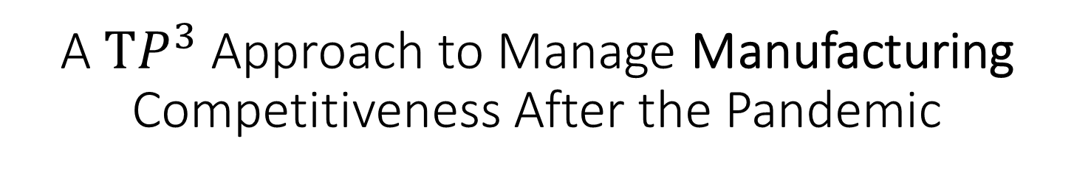
A $TP^{3}$ Approach to Manage Manufacturing Competitiveness After the Pandemic
Ananth V Iyer
Angus McLeod
Roy Vasher
Steve Dunlop
DCMME (Dauch Center for the Management of Manufacturing Enterprises)
Krannert School of Management
Purdue University
West Lafayette, IN 47907

Slide 2
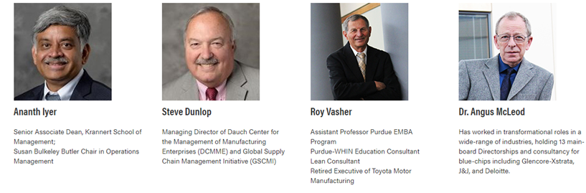
Introductions

Slide 3
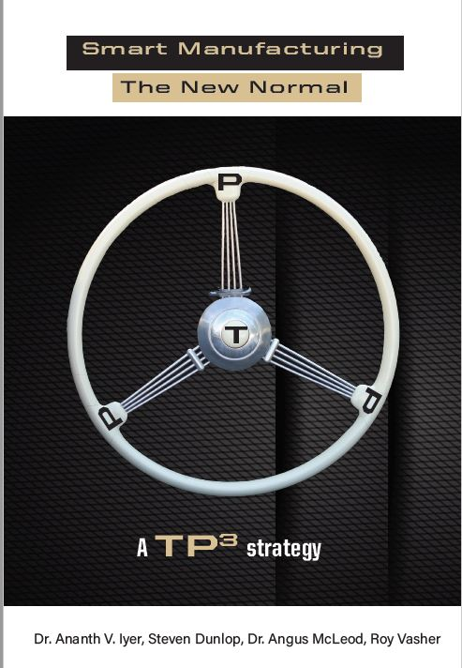
Steering Manufacturing Strategy
People
- need more real time information
Data to keep safe and alerts to ensure safety
Financial reassurance
New skills to remain competitive
Provide you with options to compete
Process
- Value Stream Mapping with Infection Layer
- Agility to use capabilities
Product
Opportunity to be a dual source
Enable Reshoring
Adjust product mix
Technology
scalable, decentralized, adaptive
Dropping price points
- Lower breakevens given higher costs for labor use

Slide 4
Ideas to consider
Manufacturing Opportunity
People – Enabling Change, Communication
Process – Infection Control, Agility
Product – Supply Chain, Demand
Technology – Facilitating Competitiveness.

Slide 5
People

Slide 6
Communications, Building Trust
Manage Communication for staff, families and supply-chain:
  Under promise & over deliver
  Follow-up
Stay ahead of concerns
  Staff: reliability of infection layer, job-losses, p/time or f/time wages
  Customers/suppliers: keep in front of the news
Involve families as a new normal
  Communicate, involve, support.

Slide 7
Emergent Needs in the New Normal
Agile adaptation to infection-control advances
Up-skilling in technology (dashboards, cobots, AR, VR etc.)
Crisis Strategy: Learn-review-amend, learn-review-amend
More multi-tasking to cover unexpected absences…

Slide 8
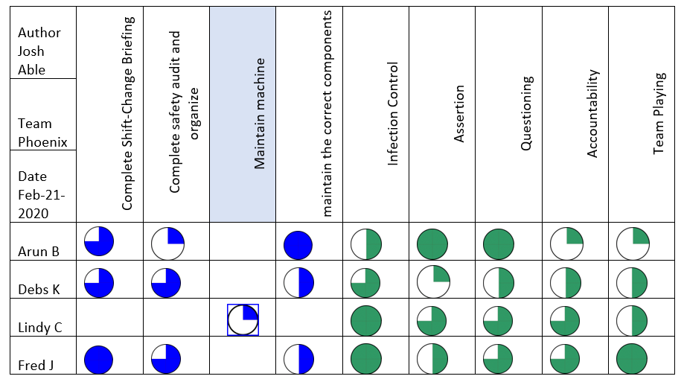
Multi-tasking Model

Slide 9
Process

Slide 10
What is VSMI?
VSMI is an acronym for Value Stream Mapping plus Infection risk mitigation.
The VSM methodology was initially used by Toyota to eliminate waste and is now a vital tool that is used by Lean practitioners everywhere.
A VSMI map provides a visual representation across the plant floor to enable you to identify potential areas of Infection risk

Slide 11

Factory Floor Flow – Aerial View – Prior Mitigation
Receiving
Aisle
Less than 6 Ft
Shipping
Steel
Cutting
Notch
Form
Weld
Buff
Supervisor
Less than 6 Ft
Mobile worker
Two-way aisle way
Aisle

Slide 12
Product

Slide 13
Product - Ideas/Decisions
Need to fully understand current and future Supply Chain
Supply Side
  Business as we know it is going to change
    New product
    Replacement of current products
  New operations – methods, processes (see process section)
  Supplier diversification
Demand Side
  Customer (demand) focus is changing
    Current and new customers mix
    Demand Forecasting
  How we produce items is changing

Slide 14
Explore
Opportunities to leverage capacity
Collaborate
New industries
Reshoring
Incorporating technology
Later …discuss leveraging local clusters to compete

Slide 15
Leveraging Technology

Slide 16
Technology and Manufacturing Recovery
Technology Adoption needs to be re-examined
Economically feasible at lower volumes
Scalable, Reconfigurable, decentralized choices
Examples

Slide 17

Recovery and Technology - Think T$P^{3}$
Cleaning Robots
Assistive Robots
Sensor based tracking and alerts (Bluetooth, RFID etc)
Surface and object quarantines
UV Technology and Virucidal cleaners
Omnichannel
Leveraging ML and AI (as appropriate)
Video Analytics
Digital Twins
AR and VR
Airflow Monitoring
Remote Learning …….

Slide 18
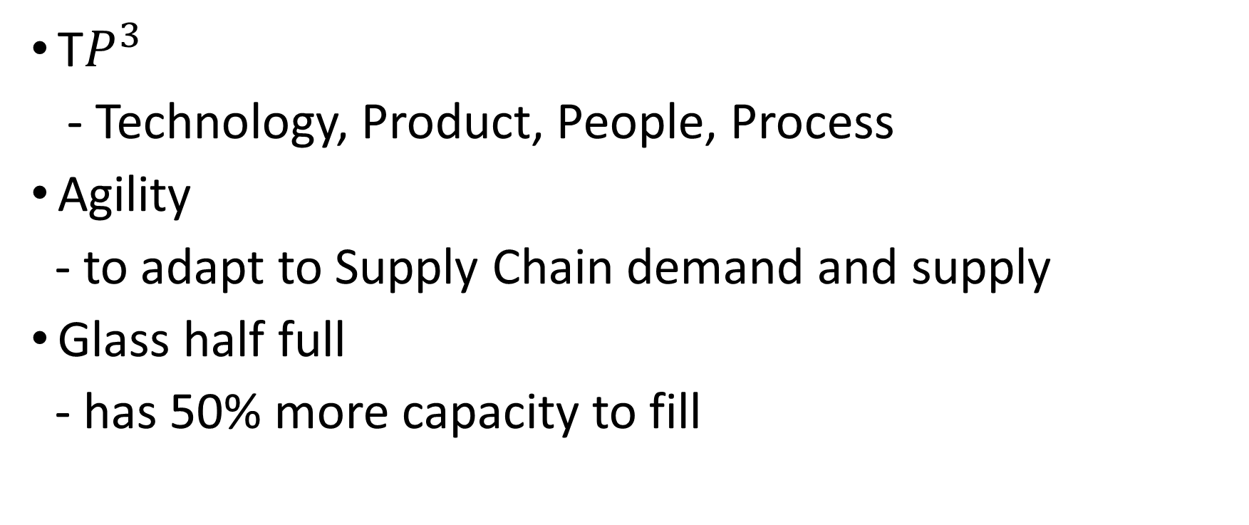
Ideas
T$P^{3}$
- Technology, Product, People, Process
Agility
- to adapt to Supply Chain demand and supply
Glass half full
- has 50% more capacity to fill

Slide 19
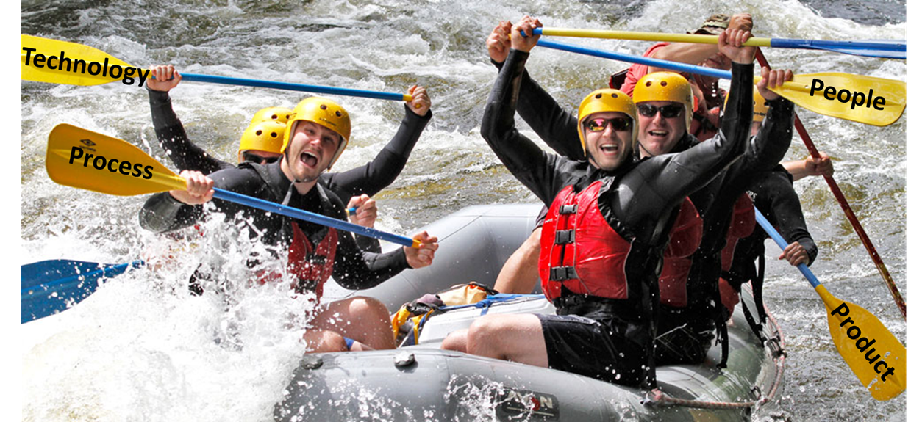
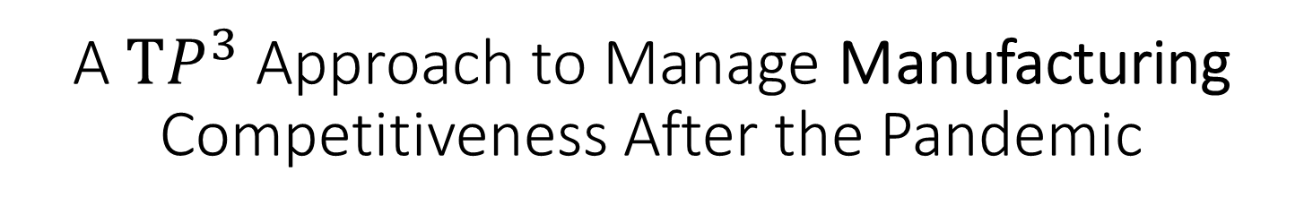
A $TP^{3}$ Approach to Manage Manufacturing Competitiveness After the Pandemic
Questions
Ananth V Iyer
Angus McLeod
Roy Vasher
Steve Dunlop

