Slide 1
Use of Digital Twins in Smart Manufacturing
Prith Banerjee, Ph.D.
Chief Technology Officer
September 18, 2020

Slide 2






Ansys is the Simulation Leader
MISSION: Empower our customers to design and deliver transformational products
FOCUSED
TRUSTED
PROVEN
GLOBAL
More than
100
4,200+
employees globally
97
45,000
Member of the prestigious
This is all we do.
Leading product technologies in all physics areas. Largest development team focused on simulation
100
customers worldwide
of the
500
ISO 9001
industrials
$25B+ market capitalization
CERTIFIED
LARGEST
INDEPENDENT
COMMITTED
DRIVEN
3x
Long-term financial stability
CAD/PLM/IoT agnostic
Open Architecture
Overall customer satisfaction globally is at
Helping customers address new market challenges: digitalization, 5G, autonomy, electrification, additive and digital twins
the size of our nearest
89%
competitor (revenue)
$1.5 Billion
2
Notes:
corporate overview

Slide 3
Agenda
Ansys Technology Strategy
Smart Manufacturing
Digital Twins in Manufacturing
Education Grand Challenge and Solution

Slide 4









Ansys Offers a True Simulation Platform
COMPREHENSIVE SOLUTIONS: Autonomy / Electrification / 5G / IIot
SYSTEMS &
EMBEDDED SOFTWARE
Embedded Software
Digital Twins
Fluids
Structures
Electromagnetics
Semiconductor
Design Exploration
Optical
MATERIALS INFORMATION
PLATFORM AND CLOUD
Notes:
ANSYS was founded 50 years ago with our core Mechanical and Structural Analysis software by solving second order partial differential equations called Euler equations using the finite element method. Subsequently we acquired the ability to solve Fluid Dynamics problems by solving the Navier Stokes equations by acquiring CFX and Fluent. Next we acquired abilities to solve Electromagnetics problems by solving Maxwells equations by acquiring ANSOFT. Over the years we now have acquired the ability to provide the best of breed individual physics solvers for our customers. We continue to innovate in each of the solver areas each year.
In recent years, our customers have asked us to solve Multiphysics interactions, where we can model the Fluid-Structure Interactions, or Fluid-Structure-Electromagnetic interactions. To support such activities we have created a simulation Platform that allows our individual solvers to interact with other solvers using strong coupling within each solver iteration, medium coupling between solvers, and weak coupling using Reduced Order Models
This platform allows our solvers to run on the desktop, on prem data centers, as well as on the private Cloud or Public Cloud. Our ANSYS cloud runs on Microsoft Azure.
Finally last year we acquired Granta which allowed us to provide a Materials Information Platform. This platform allows us to integrate more than 30,000 different materials properties to drive the detailed simulations of our structural analysis solvers, and fluid dynamics solvers, and electromagnetics solvers.
No other simulation platform in the industry has the depth and breadth of simulation capabilities.
Finally we are allowing our customers to innovate and solve incredibly complex challenges in areas like 5G, autonomy, electrification and the industrial internet of things. We have therefore started building comprehensive solutions for autonomy with BMW, for electrification with VW, with 5G with ESILICON and LG, and IIOT and Digital Twins with EDF and Kaiser.

Slide 5







Ansys Long-Term Technology Strategy Dimensions
ARTIFICIAL INTELLIGENCE AND MACHINE LEARNING
  Simulation used to train AI methods
  AI used to improve simulation
DIGITAL AND PHYSICAL WORLDS
  AR/VR for Simulation brings digital world to physical
  IOT and Connectedness brings physical world to digital
PLATFORM FOR MULTIPHYSICS SIMULATION
  Robust Multiphysics, Multi-disciplinary Optimization
  Micro-services for simulation
DIGITAL TRANSFORMATION
  Digital Threads, Digital Continuity, Digital Twins
  Model Based Systems Engineering
HYPERSCALE SIMULATION, COLLABORATION ON CLOUD
  GPU, SMP, MPI, task based
  Quantum computing
COMPUTATIONAL METHODS IN NEW AREAS
  Integrated Computational Materials Engineering
  Computational Chemistry, Biology, Healthcare, Photonic IC
PREDICTIVE AND ROBUST DESIGN
  High accuracy, adaptive numerical methods
  Materials variation and uncertainties
FUTURE OF SIMULATION
  ML based PDE -Solver, generative design
  Integrated synthesis and verification
  Automated mixed mode (0D-4D), MF, MS simulation
Notes:
While I have highlighted some of the breadth and depth of our solvers, and the platforms and solutions in the previous slide, let me now explain our long term technology strategy that has 8 areas of investment.
ARTIFICIAL INTELLIGENCE AND MACHINE LEARNING
Simulation used to train AI methods such as autonomous driving
AI used to improve simulation such as physics informed neural networks to accelerate simulation
PLATFORM FOR MULTI-PHYSICS SIMULATION
Robust Multiphysics simulation, to enable Multi-disciplinary Optimization
Microservices for simulation such as preprocessing, meshing, various solver methods, postprocessing
HYPERSCALE SIMULATION, COLLABORATION ON CLOUD
Different forms of parallelism such as GPU, SMP, MPI, Task based, and Quantum computing?
We will enable Real Time Simulation using Exascale Computing in the future.
PREDICTIVE AND ROBUST DESIGN
High accuracy, adaptive numerical methods in the presence of material variations and uncertainties
Integrated Verification and Validation
Uncertainty Quantification
DIGITAL AND PHYSICAL WORLDS
AR/VR for Simulation brings digital world to physical
IOT and Connectedness brings physical world to digital
DIGITAL TRANSFORMATION
Many of our customers are going through Digital Transformation
Their journey involved the notions of Digital Threads, Digital Continuity, Digital Twins, and Model Based Systems Engineering
We are working with our customers on Simulation-led engineering outcomes
COMPUTATIONAL METHODS IN NEW AREAS
Integrated Computational Materials Engineering
Computational Chemistry, Drug Design, Healthcare,
Photonic IC, 3D IC, Digital Manufacturing
FUTURE OF SIMULATION
ML based PDE-Solver, Generative design
Integrated synthesis and verification
Automated Mixed mode (0D-4D), MF, MS simulation
In the next four slides I will provide more details on four of these areas, AI/ML, Platform, HPC, and Healthcare.

Slide 6
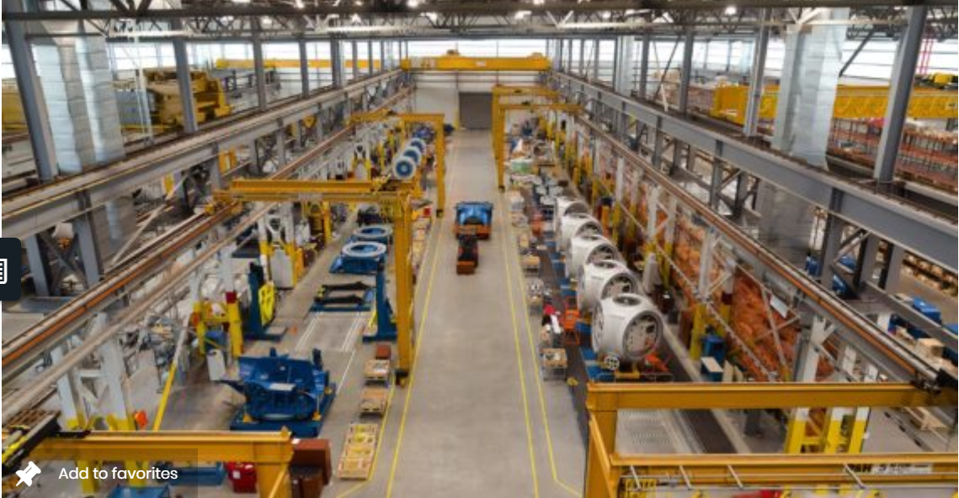
Smart Manufacturing
Use of Digital Technologies in Manufacturing (Industry 4.0)
Industrial IOT
  sensors, connectivity, cloud
Wired and Wireless Networking (WIFI/Bluetooth/3G/4G)
  Private networking and 5G splicing
Cloud, Mobility, and Big Data Analytics
Industrial Automation
  DCS, PLCs, Drives, Controllers
Robotics and Warehouse Automation
Augmented Reality and Virtual Reality
AI/Machine Learning and Generative Design
Additive Manufacturing
Operational Equipment Efficiency (OEE)
  Availability * Productivity * (1 - Defect Rate)

Slide 7
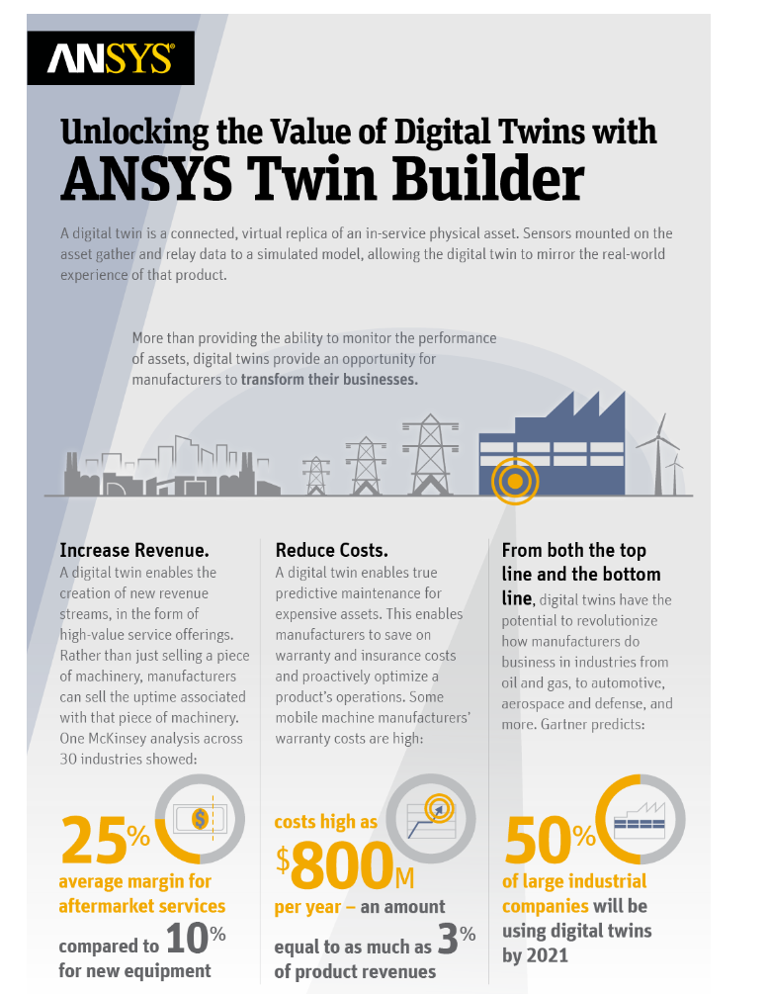
What is a Digital Twin?
A digital twin is a connected, virtual replica of an in-service physical asset.
Sensors mounted on the asset gather and relay data to a simulated model (the digital twin) to mirror the real-world experience of that product.
Digital Twins enable tracking of the past behavior of the asset, provide deeper insights into the present and most importantly, they help predict and influence future behavior

Slide 8





Process and Manufacturing industries adopters of Digital Twins
Digital Twins are attractive for assets with high economic impact
Oil & Gas
Power Gen
Chemical
Others
Aerospace
Automotive
Healthcare
Others
40,000 (2019)
450,000 (2026)
35,000 (2019)
450,000 (2026)
15,000 (2019)
800,000 (2026)
15,000 (2019)
90,000 (2026)
20,000 (2019)
1,800,000(2026)
2,000 (2019)
700,000 (2026)
Number of Critical Assets
~65-70%
~30-35%
Process Industries
Discrete Manufacturing Industries
Compressors, Pumps, Pre-heaters, Electric Motors, Turbo Alternator, Turbines, Heat Exchangers, Boilers, Condensers, Refrigeration systems, Cooling Towers, Distillation columns, Oil Rigs, Generators etc.
Engines, Pumps, Compressors, Robotic Machines (for welding , painting), Assembly machines, Landing Gears, Li-ion battery, Powertrain, Maritime propulsion systems etc.
Examples of Assets
deployed
Source: Industry Research, Baker Hughes, Expert consultations, Evalueserve Analysis

Slide 9

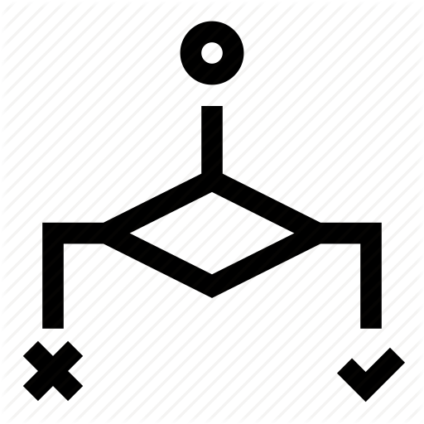

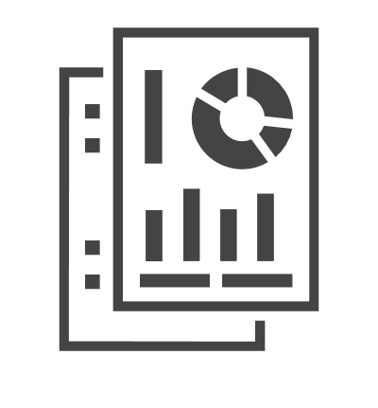
Customers are putting simulation at the center of their Digital Twin implementations
Simulation-based
Digital Twins
Virtual Sensors to Simulate Critical Quantities
Perform What-ifs before applying a solution
+
IIoT and
Data Analytics
Physics Based Accuracy,
Improved ROI
Generate baseline and failure data using Physics

Slide 10
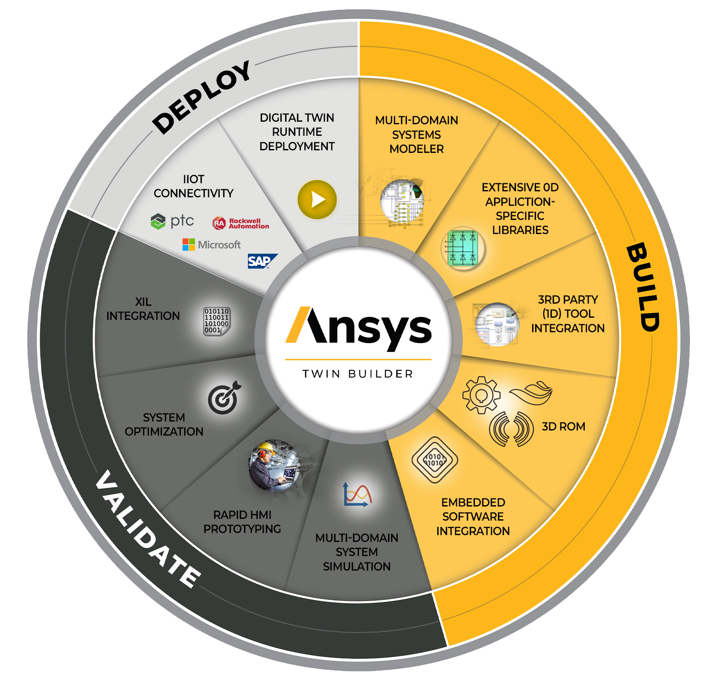
Ansys Twin Builder: A unique product to build, validate and deploy simulation-based digital twins
Multi-technology platform
State-of-the-art reduced order modeling
Interoperability support
Ability to deploy runtimes for Digital Twin

Slide 11
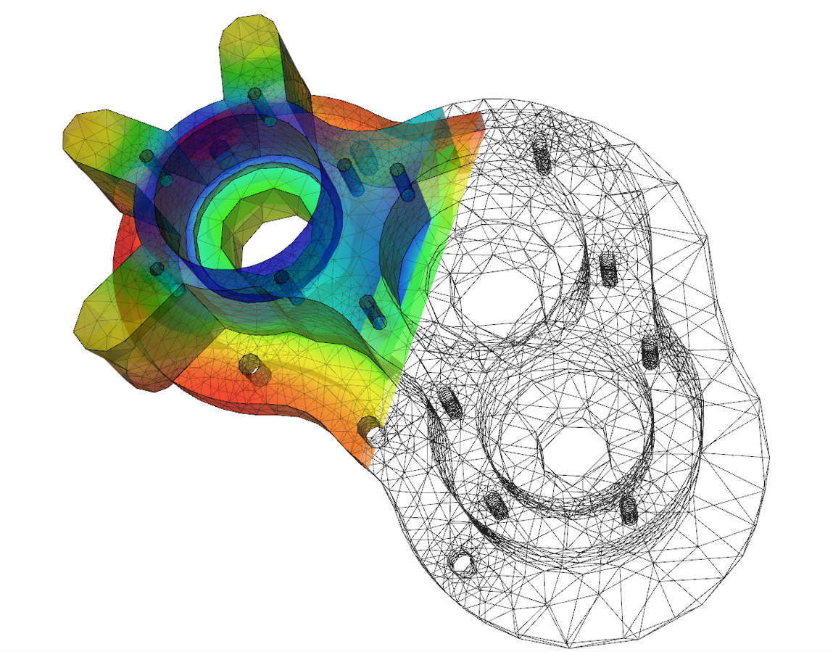

Digital Twin Challenge: Accuracy, Time & Cost
Model Development
Data-driven modeling
Design & simulation information not readily available / usable
Large volumes of process data required for training
Insufficient accuracy, limited by observed data
Long, expensive time scales to develop & deploy
Model Development
Simulation-based modeling
Difficult to accurately model the as-operated performance of equipment
Lacking ability to incorporate available data into models
Notes:
Data-driven modeling: model is only as good as the data it has seen

Slide 12
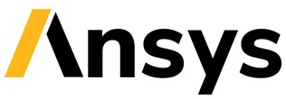

Digital Twin Ecosystem
Broad-based industrial, tech and cloud platform ecosystems
Digital Platforms from
Industrial Incumbents
Industrial Data & AI Platforms
Built-on pure operational data
from fleets of assets
Automation players: ABB Ability Platform, Schneider Ecostruxure, Siemens Mindsphere, Honeywell Sentience, Rockwell Factorytalk
Automotive OEMs: BMW, Mercedes, Ford, GM, VW, Toyota, Honda, Tesla
Aerospace OEMs: Boeing, Airbus, GE, Rolls Royce, Pratt and Whitney, Honeywell
Energy companies: Shell, Chevron, Baker Hughes,, GE,, National Grid, Duke Energy
Professional services based specialized model development from commodity AI
C3.ai, Uptake, Spark Cognition, Tignis
Unique combination of AI and simulation based approaches for higher accuracy, faster industrial optimization
Cloud Service Providers
Simulation and CAD Incumbents
Data analytics and IoT gateway stacks for connecting assets to the Cloud
AWS, MSF Azure, Google Cloud Platform, IBM
Built-on pure simulation based approaches
ANSYS, Dassault Systèmes, Siemens, Hexagon, PTC, Autodesk

Slide 13
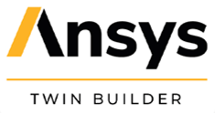

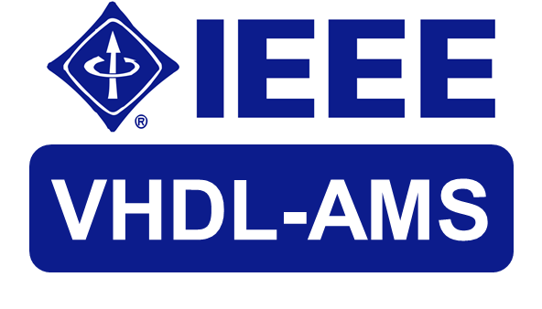

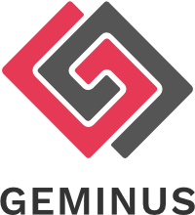
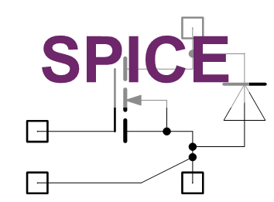

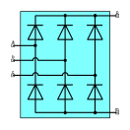




Twin Builder Architecture and Workflow with Geminus
Data-based ROM
Software,
Control Models
Test Data
Twin Model for Offline Compute
System Model
Hybrid Physics-AI Modeling
Data Integration, Auto-calibration, …
+ +
ROM
Solver
Twin Model for cloud/edge deployment
ROM Extraction Capabilities
LTI & LPV
Static
Dynamic
System Libraries
Twin Builder
IoT gateway
FMU for Simulation
workflows
Asset performance data
Validated 3D Physics Models

Slide 14
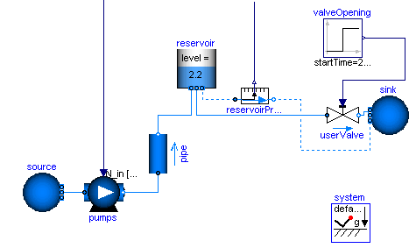
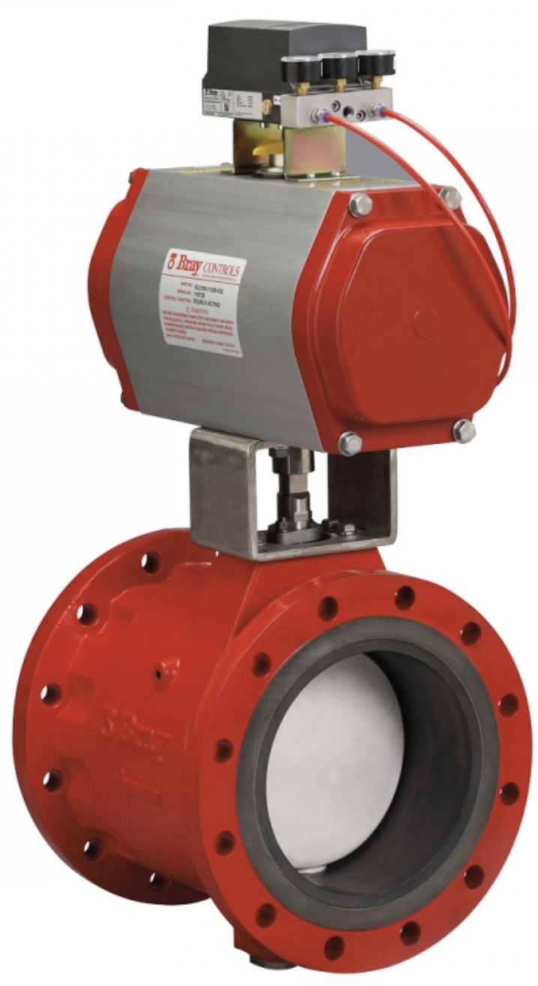
Use Case: Asset OEM
Digital Twin of Industrial Valve Asset
1
4
Create asset model from system component libraries & ROMs
Deploy online in asset health monitoring infrastructure
Asset
Twin
Optimize Asset Performance & Uptime
Deployed model auto-calibrated with sensor data
3
Geminus
Hybrid Physics-AI Modeling
Automated Hybrid modeling workflow optimizes accuracy by fusing physics with asset performance data
2
Ingest operational & historian data from existing sensors
IoT gateway
Valve
Asset
Pressures, flow rates, currents, …)
14

Slide 15
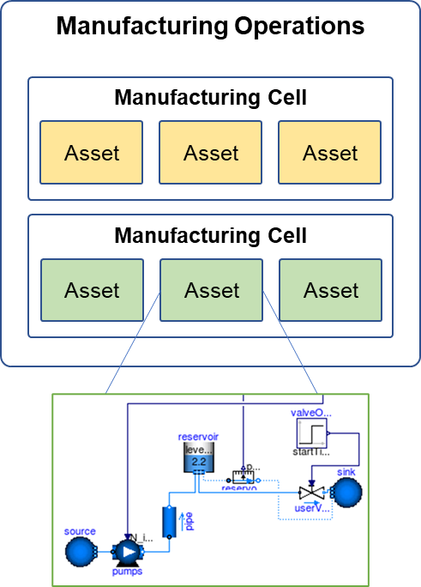
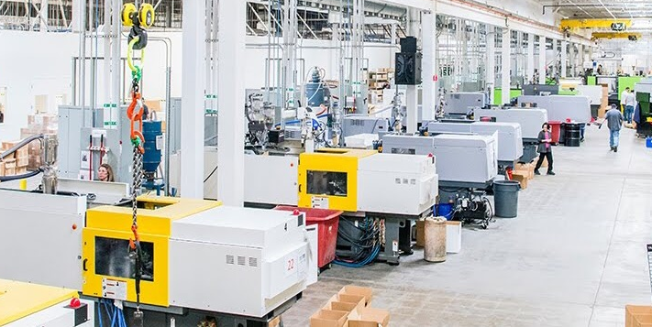
Use Case: Industrial Operations
Digital Twin of Manufacturing Operations
1
4
Assemble system-level model from component libraries
Deploy online in production management infrastructure
Process
Twin
Optimize Process Yield, Throughput & Availability
3
Geminus
Hybrid Physics-AI Modeling
Automated Hybrid modeling workflow optimizes accuracy by fusing physics with process data
2
Ingest operational & historian data from existing sensors
IoT gateway
Process
Streaming / stored process data
15

Slide 16

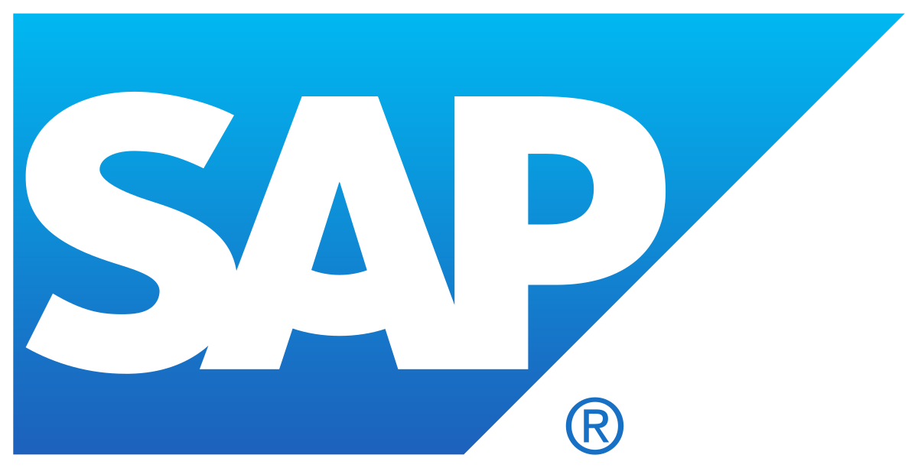









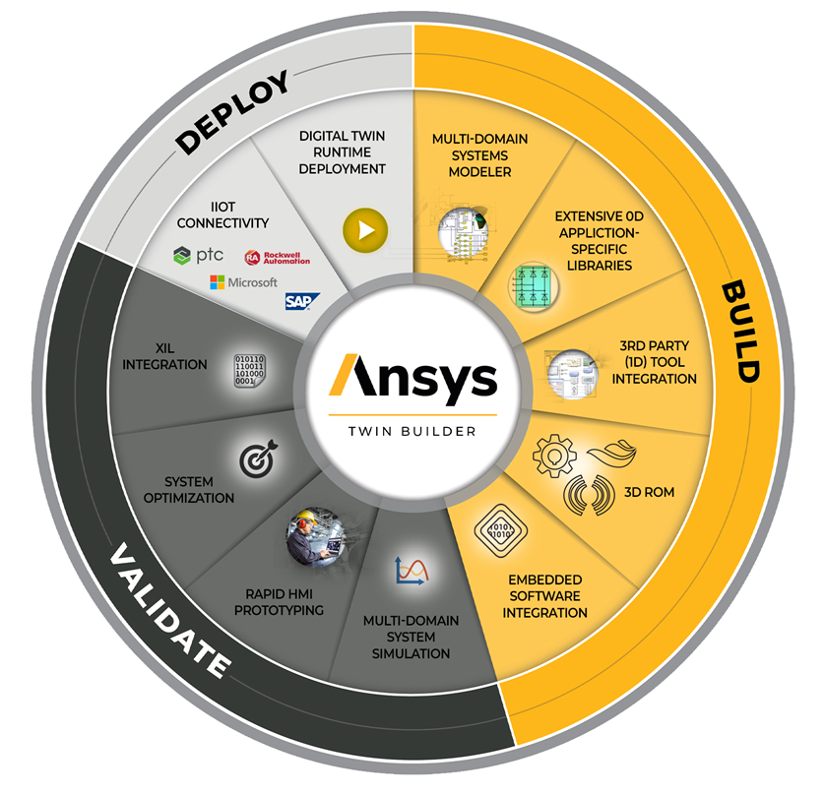
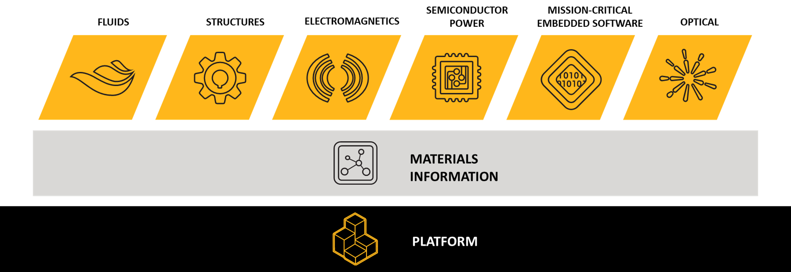
Ansys’ Partnering Landscape for the IoT Platform
Applications
General purpose/Vertical
IIoT Platforms
Digital Twin Partners
Services
Analytics, AI/ML, Time Series, etc
PEI+PdMS
IIoT Platform
Partners
Azure Digital Twins
IoT and Edge
Infrastructure
Communication, DBs, OS, etc
Customer-
Partners
ANSYS Twin
Runtimes
Azure IoT
Hyper-scalars
Compute
Cloud, Edge, Desktop
Azure IoT Edge
Azure Cloud
Azure Cloud
Assets
Equipment

Slide 17

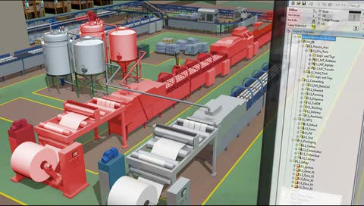
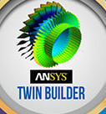
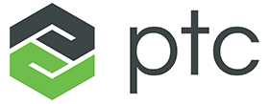

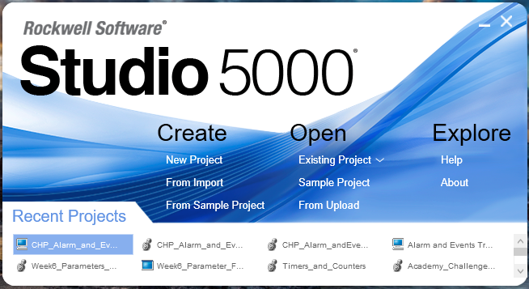

and Rockwell Automation Partnership in Manufacturing
Operations Technology Lifecycle
Design Focus
Operations & Maintenance Focus
Design
Operate
Maintain
Development Production
Simulation-Based Digital Twin
Operationalized Twin Model for Advanced Analytics
Key Platforms
Primary Functions | Key Platforms & Technology Providers
Simulation-Based Digital Twin Reduced Order Models (ROM) Production System Connectivity (IIoT) Advanced Analytics Runtime Access to Live Stream & Historical Data
Simulation
Modeling
Control Systems
Emulation
Operationalized Twin Model at the Edge
Use-Case Categories | Product, Asset, System
 | Brownfield | Greenfield
Design Validation |  | X
Virtual Commissioning |  | X
"What If" Analysis | X | X
Improvement | Optimization | X | X
Change Management | X
Training | X | X
Primary Functions | Key Platforms & Technology Providers
Simulation-Based Digital Twin Reduced Order Models (ROM) Scalable Compute at the Control System Advanced Analytics Runtime Live Data & Closed-Loop Interaction
Virtual
Commissioning

Slide 18

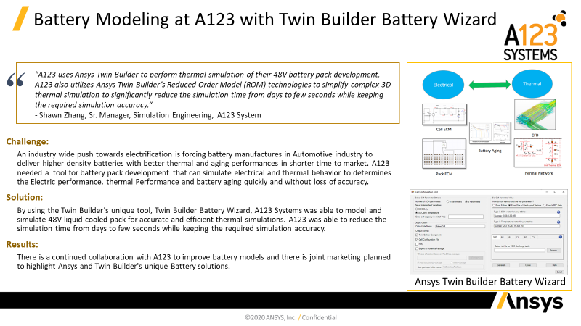
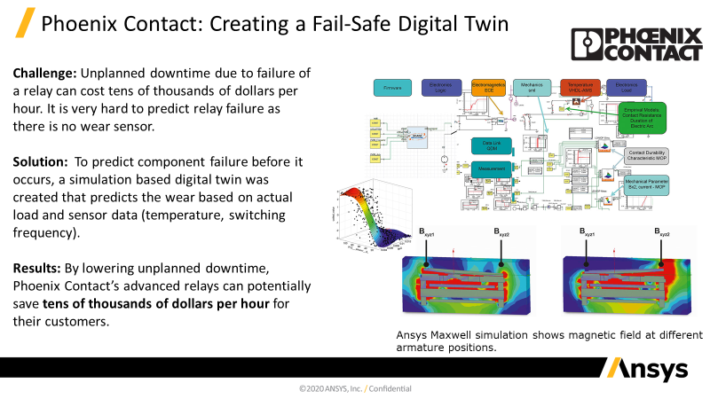
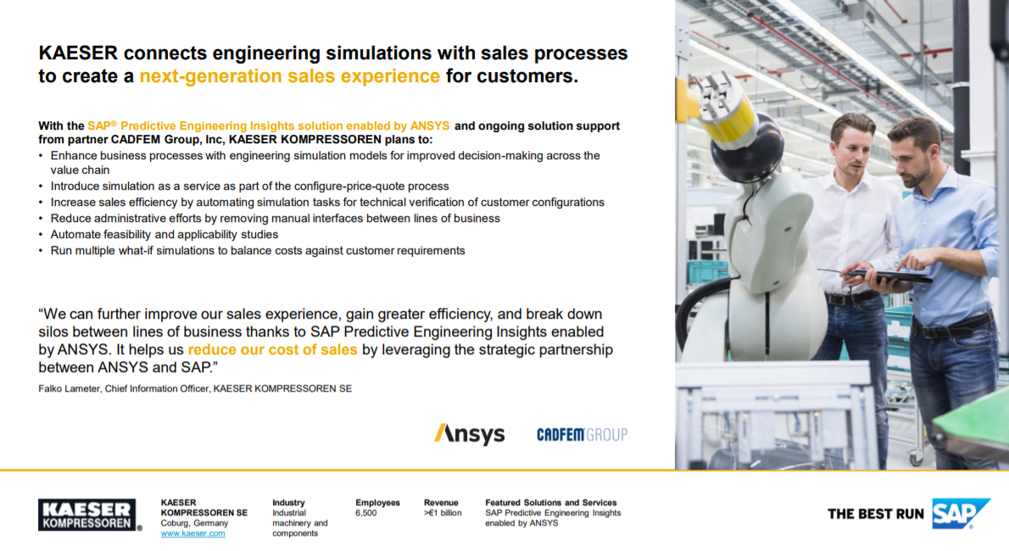
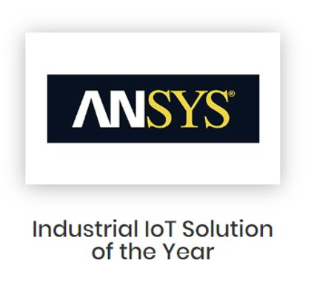
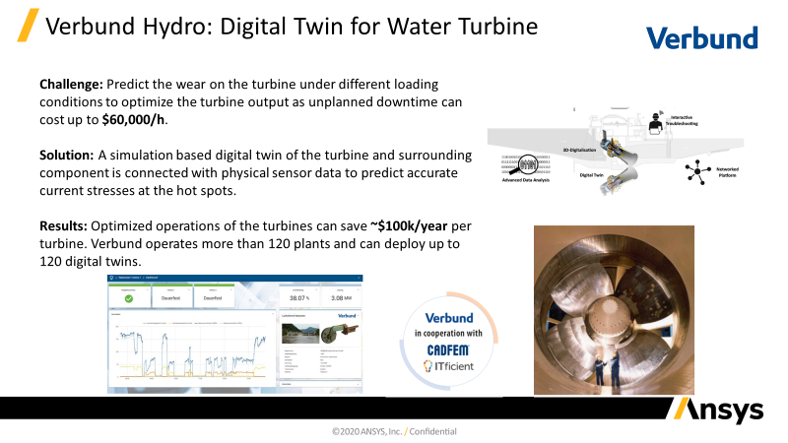
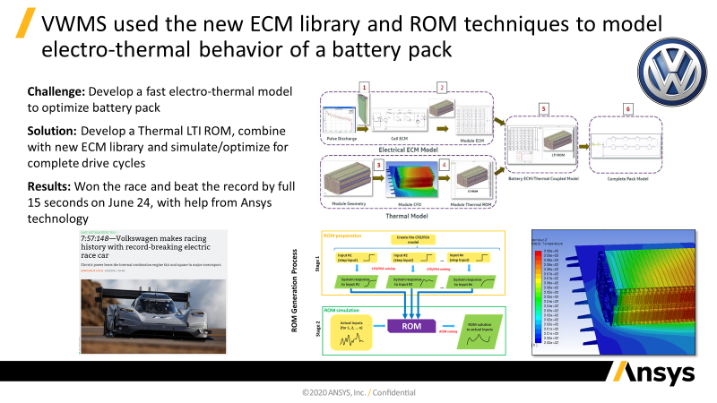
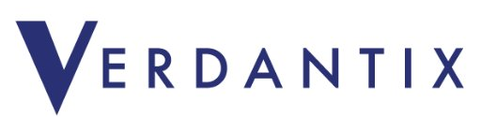
Recent Customer Success and Highlights
"Product-Centric Firms With An Industry 4.0 Strategy Should benefit from ANSYS Twin Builder"

Slide 19

Ansys leading the way in global IoT and Predictive Maintenance
Digital Twin Consortium
Ansys is one of 4 founding members
Drives the development and adoption of digital twin technologies
Emerging standards body (part of OMG)
Digital Twin Definition Language (DTDL)
Ansys and MSFT collaborating on DTDL
Enables IoT solutions to provision, use, and configure IoT devices from multiple sources in a single solution

Slide 20


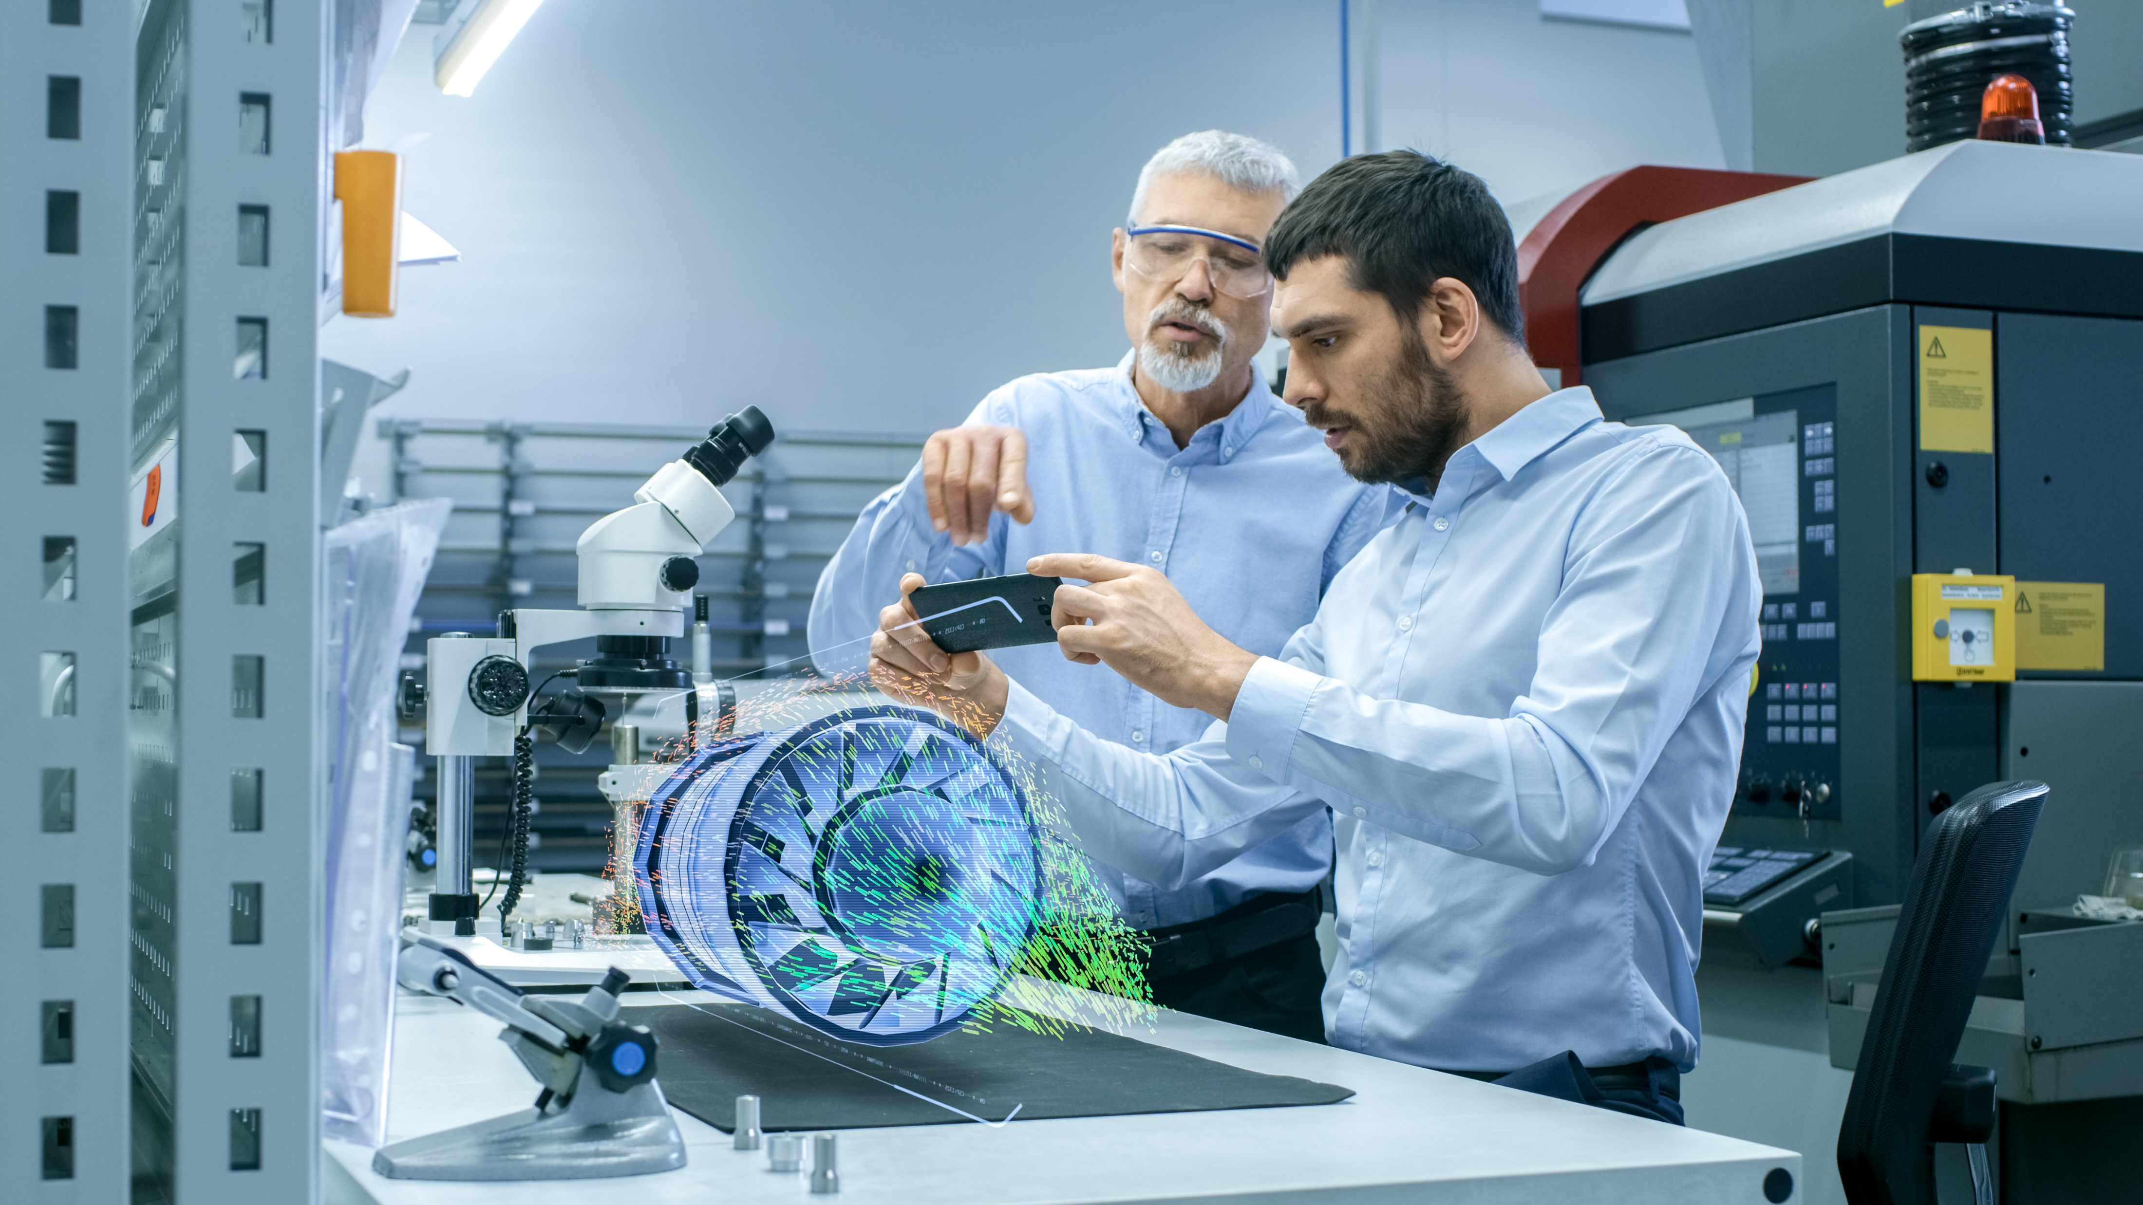
The STEM Education Grand Challenge
STEM education has traditionally relied on lectures and experiments in laboratories
Online learning platforms such as EdX, Coursera, Udemy
Universities and high schools have been compelled to use remote/online learning due to Covid-19
Laboratory experiments, workshop projects and physical prototyping will be complemented by simulation and software-based experiential learning
In the future, lectures will be a blend of brick and mortar classroom teaching augmented by online courses
Ansys Discovery empowers designers and students to create concepts leading to designs and perform design space exploration
Online courses with simulation on the cloud will allow students anywhere in the world to learn the most complex engineering disciplines
The Result: A future where the Ansys Academic Program meets the evolving needs of millions of STEM students by providing educators and students with high-quality education assets and easily-accessible simulation tools
Notes:
MOOC – Massively Open Online Courses. Platforms include Coursera, EdX, Udacity
LMS – Learning Management Systems. VLE – Virtual Learning Environment. Examples: Blackboard Learn, Google Classroom, Canvas

Slide 21
Summary
Digital Twins unlock significant top-line and bottom-line benefit for our customers
Simulation is at the center of Digital Twin implementations
Ansys Twin Builder is unique product that lets customers quickly build, validate and deploy simulation-based digital twins
Our partnering strategy is complementary and synergistic and helps our customers get to value faster
To ease adoption, Ansys is leading the way in global digital twin initiatives

